Slide 1

Introduction to GIS using QGIS
Dr. Andrea Titolo

Slide 2
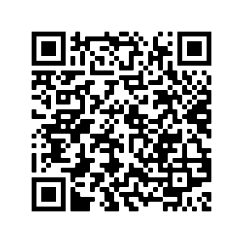
Session Info
You can download the data here at: github.com/andreatitolo/qgis_training_data/raw/main/training_data.zip
We will use data on the location of roman forts, settlements and roads in Britain (freely available from the Ancient World Mapping Center website and national boundaries of UK and Ireland (freely available at NaturalEarthData website).
Today’s session:
Introduction to GIS/QGIS
Spatial Data Types (Vectors/Raster)
Open QGIS and familiarize with the interface
Load vector data
Inspect and change layer style
Load CSV data
In the meantime, open QGIS!
If for any reason you are not able to follow along, you can download this presentation in pdf which has all steps of this session illustrated at:
github.com/andreatitolo/qgis_training_data/raw/main/AT_Introduction_to_qgis.pdf
Or scan the QR code on the right with your phone!

Slide 3
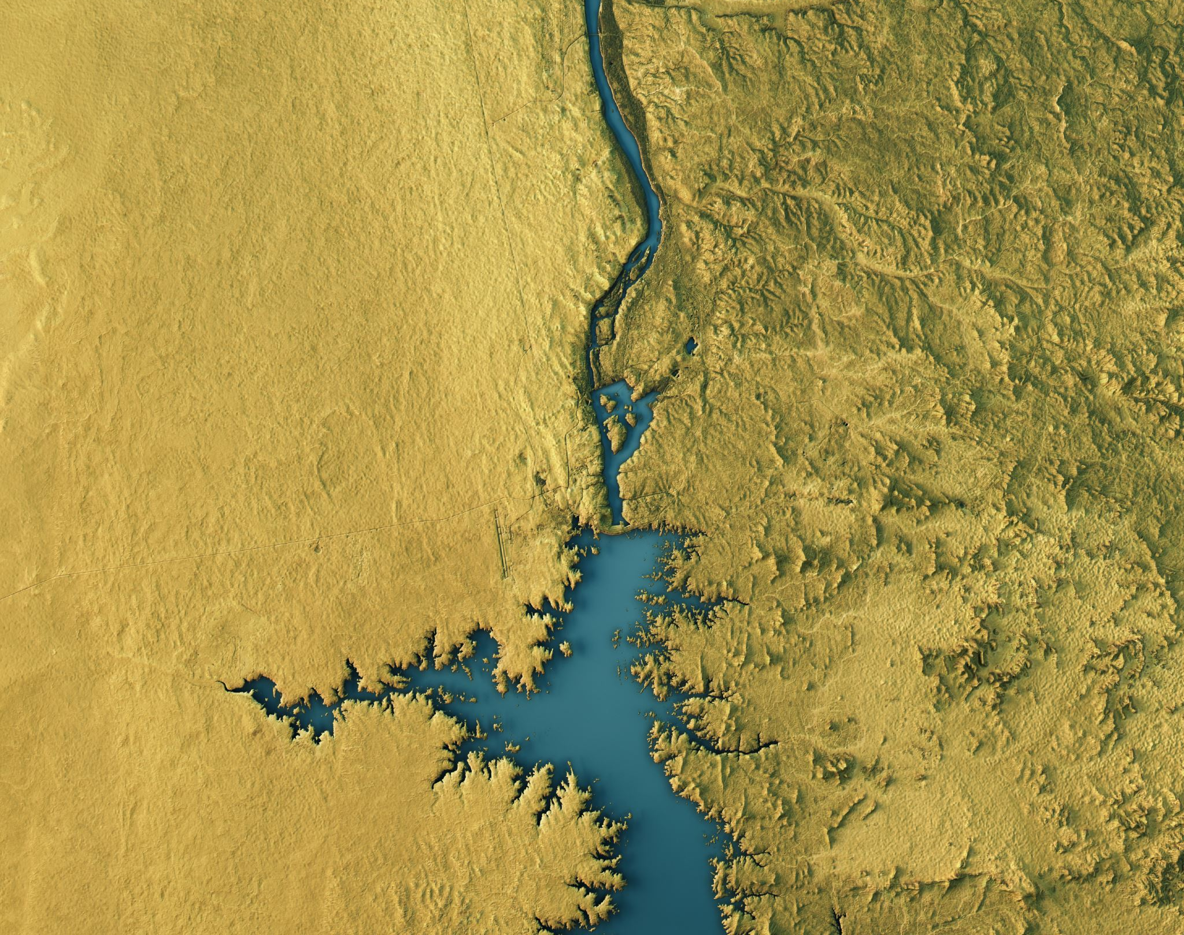
What is a GIS?

Slide 4
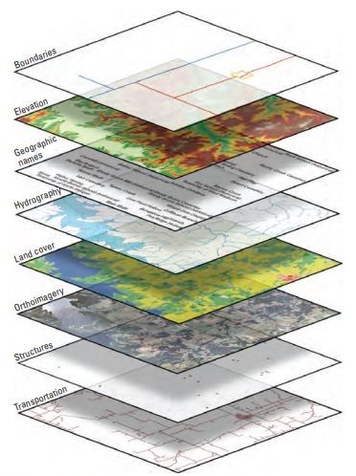
GIS stands for either Geographic Information System Software/programs that we use to store, manipulate, analyse, manage, and present all types of geographical data and to analyse relationships between those data.
What is a GIS?

Slide 5
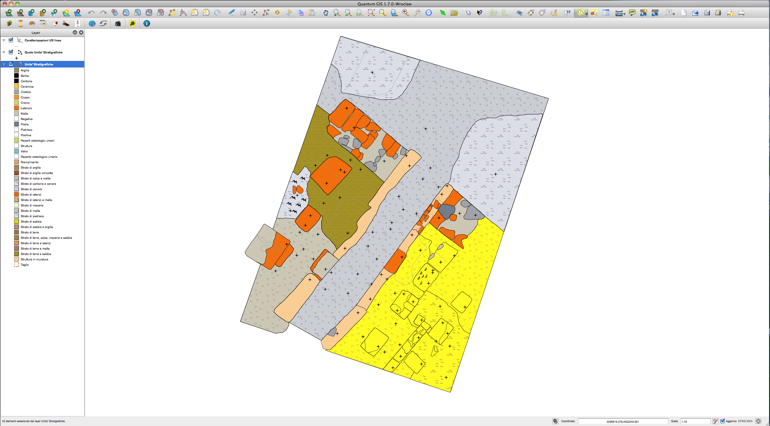
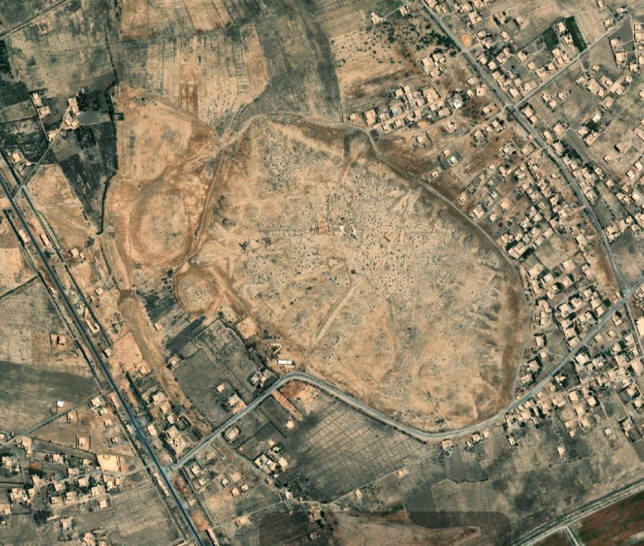
What can GIS do for Archaeology?
A large variety of applications:
Mapping
Site Detection
Archaeological Survey – Field recording
Archaeological Excavation
Cultural Heritage Recording and Monitoring
More complex tasks (e.g. Spatial Analysis)
3D
WebGIS
PyArchinit plugin for QGIS, main interface with stratigraphical units displayed.
The archaeological site of Mari (Tell Hariri) in Syria, as seen from Google Earth satellite image.

Slide 6


Slide 7

What is QGIS?
From the QGIS website, "QGIS is a user friendly Open Source Geographic Information System (GIS) licensed under the GNU General Public License. QGIS is an official project of the Open Source Geospatial Foundation (OSGeo). It runs on Linux, Unix, Mac OSX, Windows and Android and supports numerous vector, raster, and database formats and functionalities."
www.qgis.org
QGIS is a desktop GIS. You have a Graphical User Interface (or GUI) that you can work with, with buttons, windows or forms you can fill in order to do things.
QGIS is open source. The code is available to the users to read or modify. What's the advantage of this? It means anyone can make fixes if something is wrong or anyone can add new features. It is generally faster for open-source programs to fix bugs and implement new things.

Slide 8
Why QGIS?
QGIS is an community-driven, open-source desktop GIS software that allows users to visualize and analyse spatial data in a lot of different ways.
Some advantages of QGIS are:
It's a robust, powerful desktop GIS.
Runs on all major OS: MacOS, Linux, & Windows.
Free of charge, no need to worry about licences.
Frequent updates & bug fixes.
Accessible, comes in more than 50 languages (depending on the version), making it easier to work with a large variety of collaborators.

Slide 9
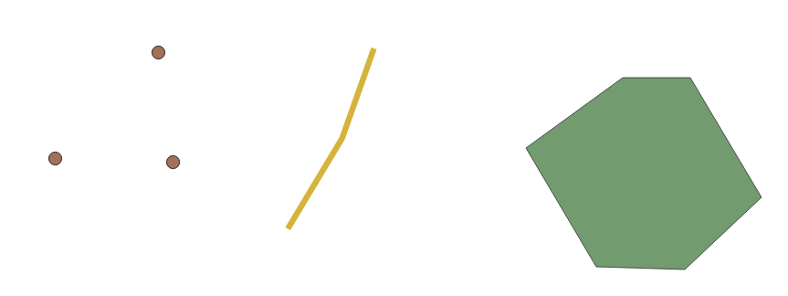
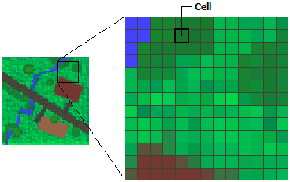
Spatial Data Types
Spatial Data = Any data related to or containing information about a physical object that has a size, shape and specific location on the Earth’s surface, and is represented in a geographic coordinate system.
Vector
Raster
Points
Lines
Polygons

Slide 10
Spatial Data Types
Spatial Data = Any data containing information about a physical object that has a size, shape and a specific location on the Earth’s surface. This location is recorded with geographical coordinates.
Vector
Raster
Points
Lines
Polygons

Slide 11
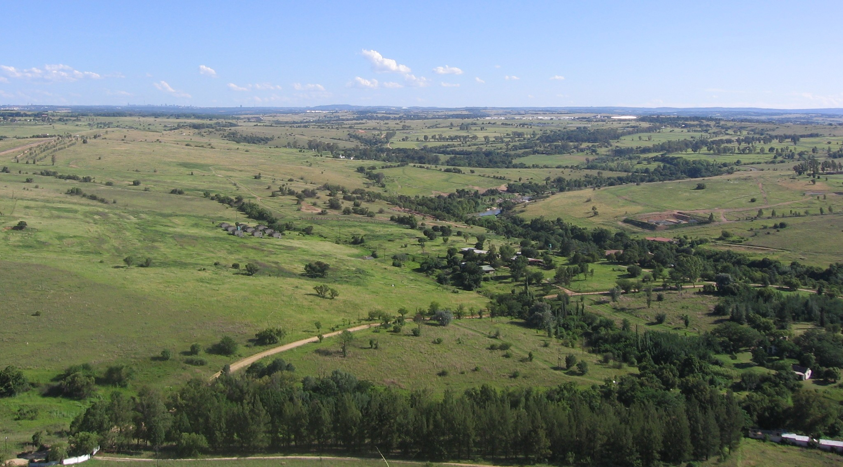
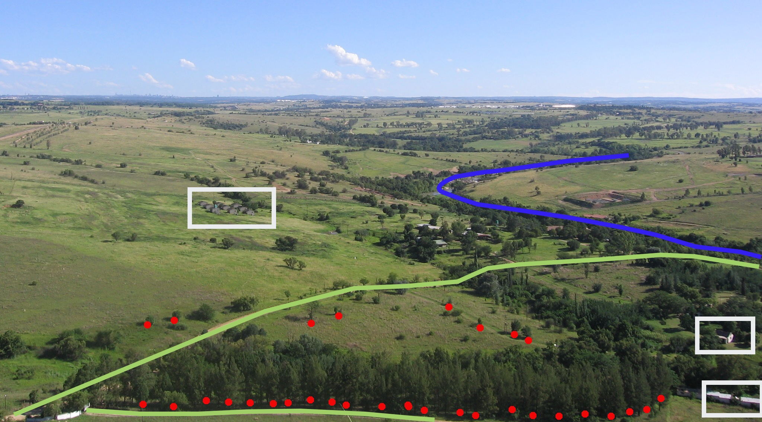
Vectors
A representation of the real world using three geometries: points, lines and polygons .
They have attributes, which consist of text or numerical information that describe the features.
Better at representing discrete data (i.e. data present in specific locations, e.g. Rivers, Buildings, Roads, Trees).
Stored in different file formats, most common are the shapefile (.shp) and comma separated value (.csv).
In archaeology
Points -> Find Spots, Archaological Sites on a regional map
Lines -> Linear Features (e.g. paleochannels)
Polygons -> Stratigraphical Units, Structures, Site extent
Real world landscape and its features as we would represent them in GIS using vector geometries (source: QGIS Documentation).

Slide 12
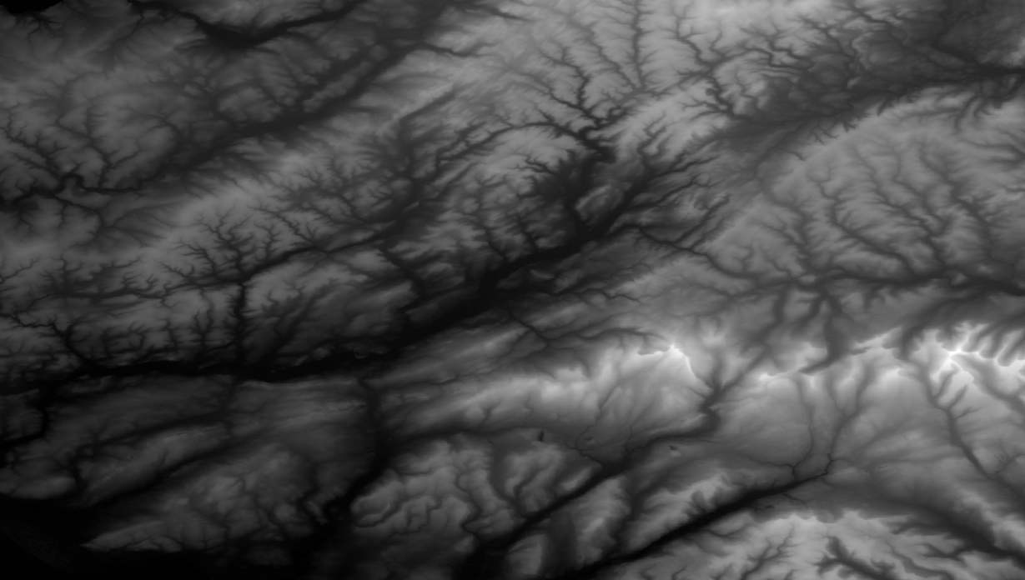
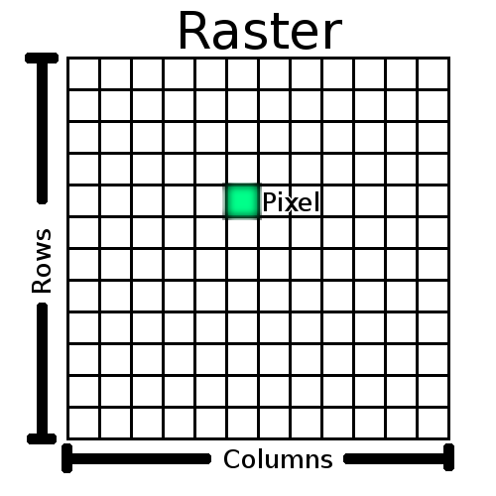
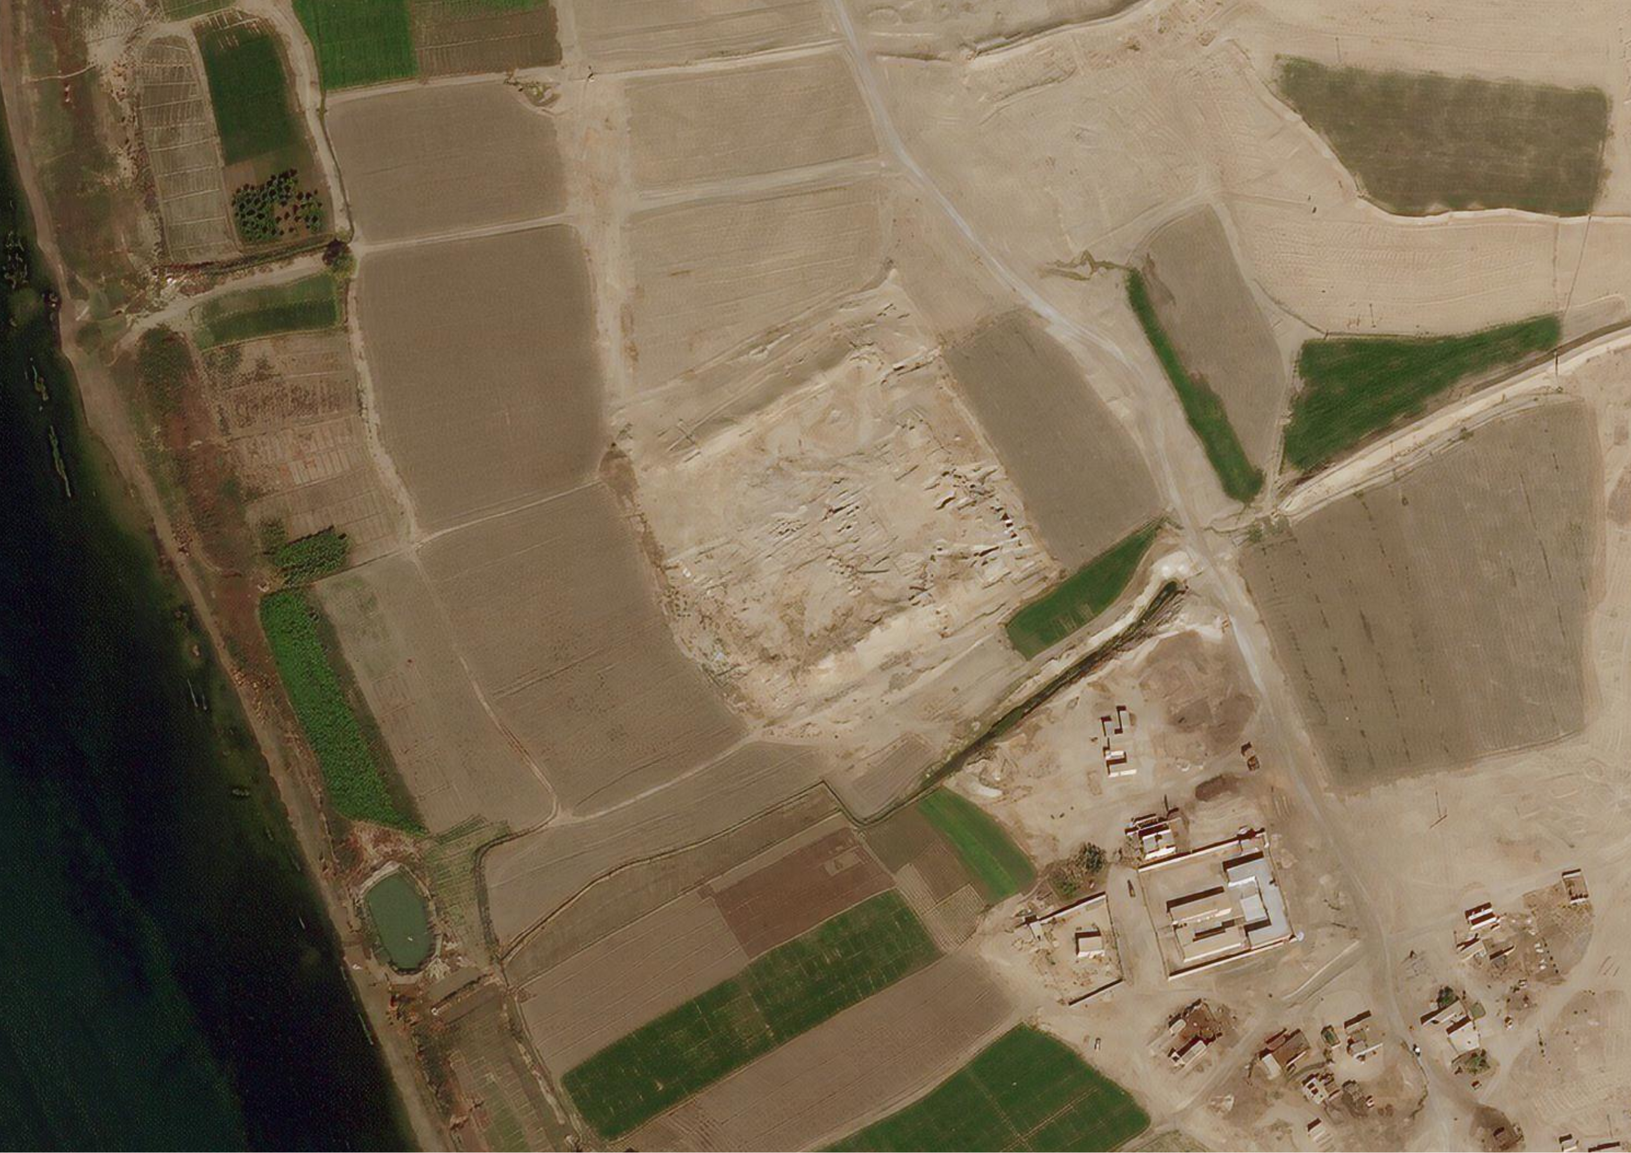
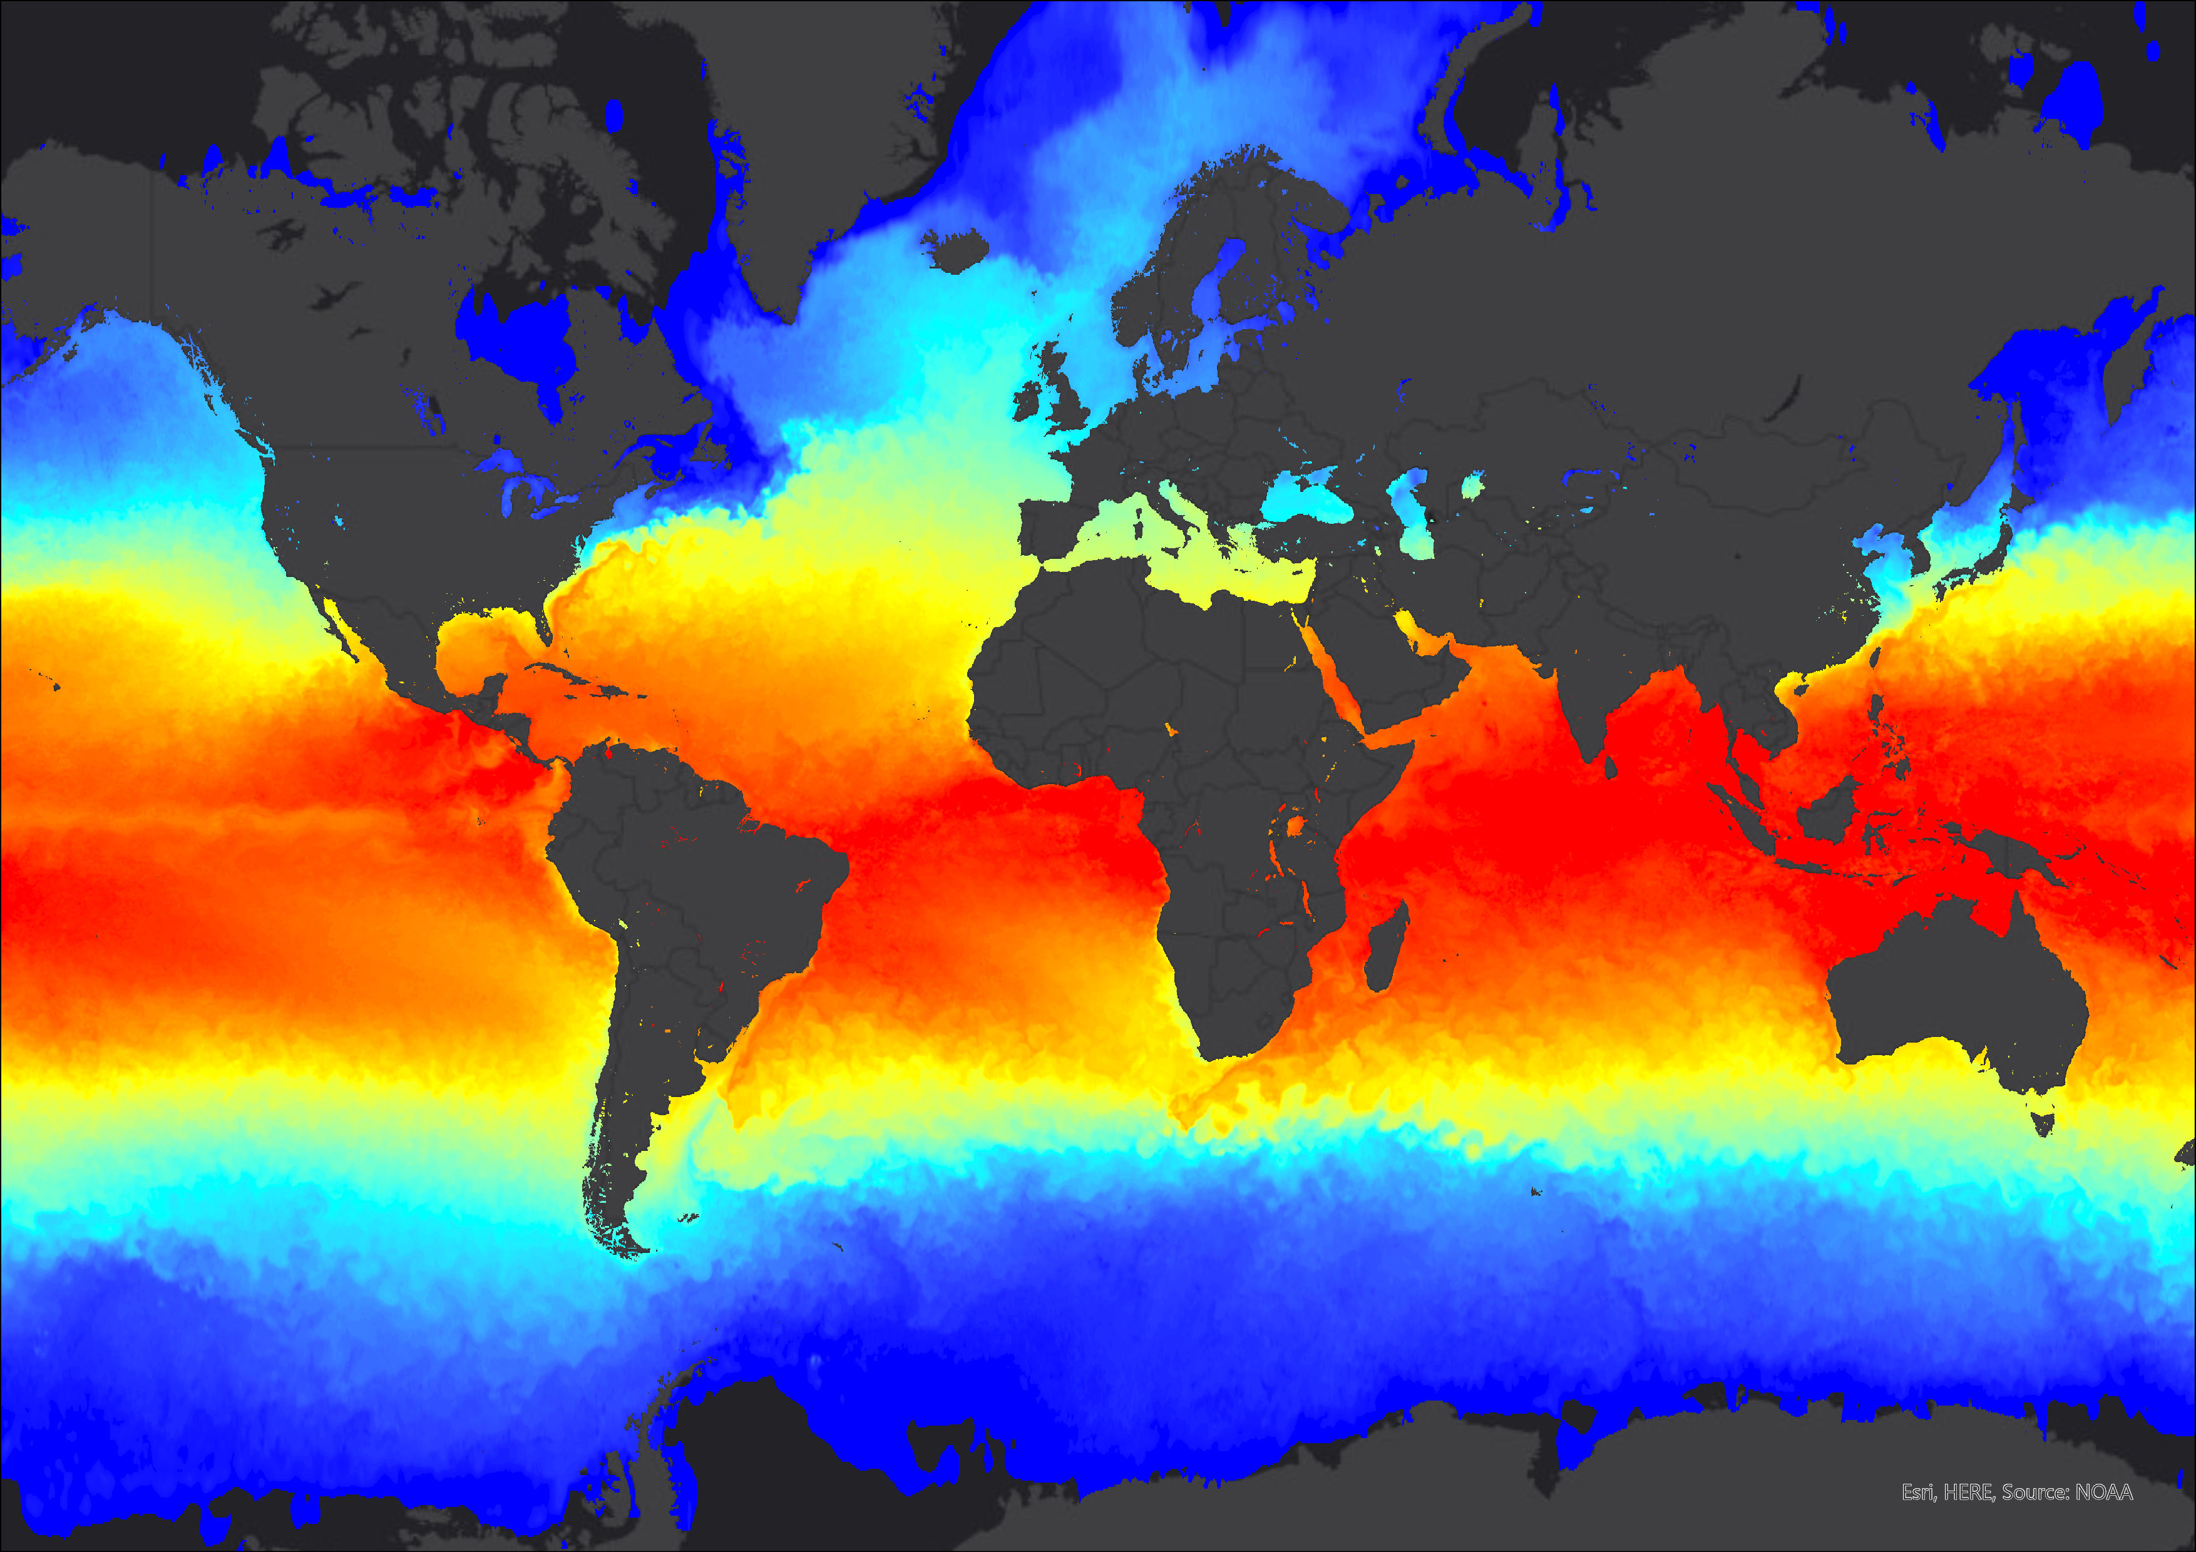
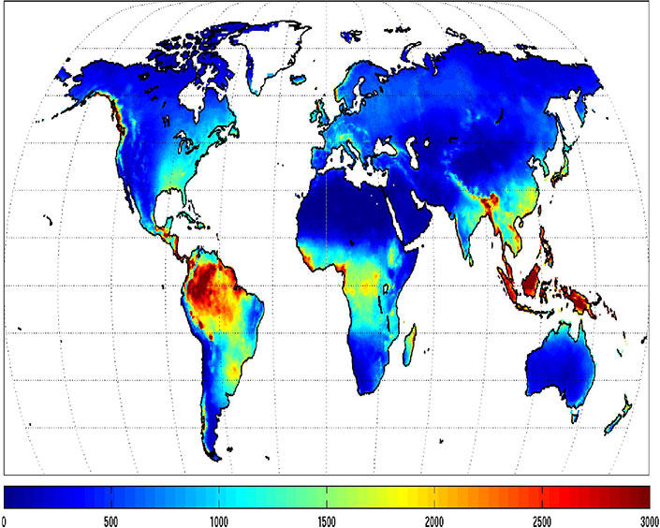
Rasters
Gridded data: made up of an underlying grid of cells (pixels), each of which is attributed a numeric value.
Each cell contains information about what should go into that cell.
Better at representing continuous data
Stored in different file formats, most common for GIS is GeoTIF (.tif)
In archaeology
Raster data can be:
elevation data, rainfall/temperature data, satellite images, aerial/drone photos
Elevation raster image (DEM) of the area north of Swansea, Wales (@USGS)
Raster data structure (source: QGIS documentation)
Archaeological site of Haradum in Iraq, as seen on a Bing Maps satellite image (@BING).
Sea temperature raster data (source: @Esri/NOAA)
Global average annual rainfall data (source: @NASA)

Slide 13
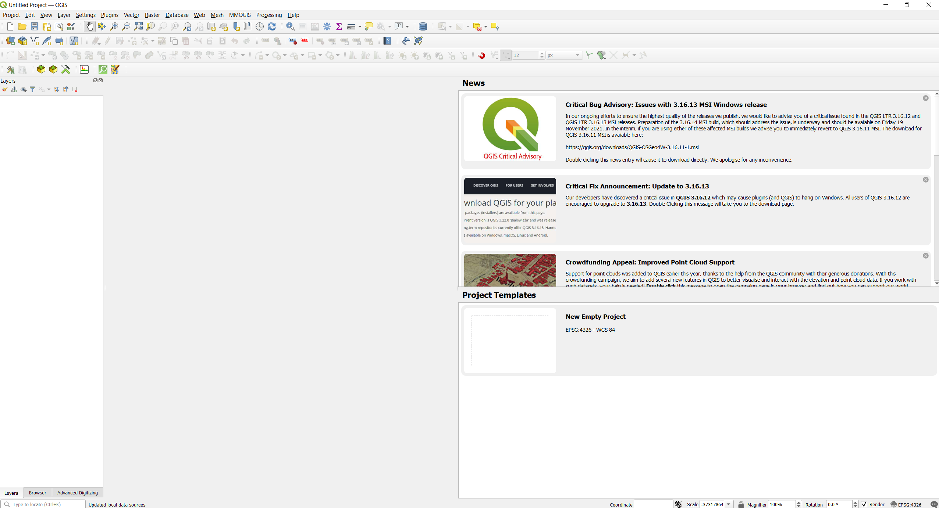
Let’s open QGIS!
(Windows) Click on the Desktop icon
(Mac) Launch the application
Or launch the program from the executable (usually found under C:\OSGeo4W\bin\qgis-ltr-bin.exe or C:\Program Files\QGIS-3.16\bin\qgis-ltr-bin.exe)
Double-click on New Empty Project

Slide 14
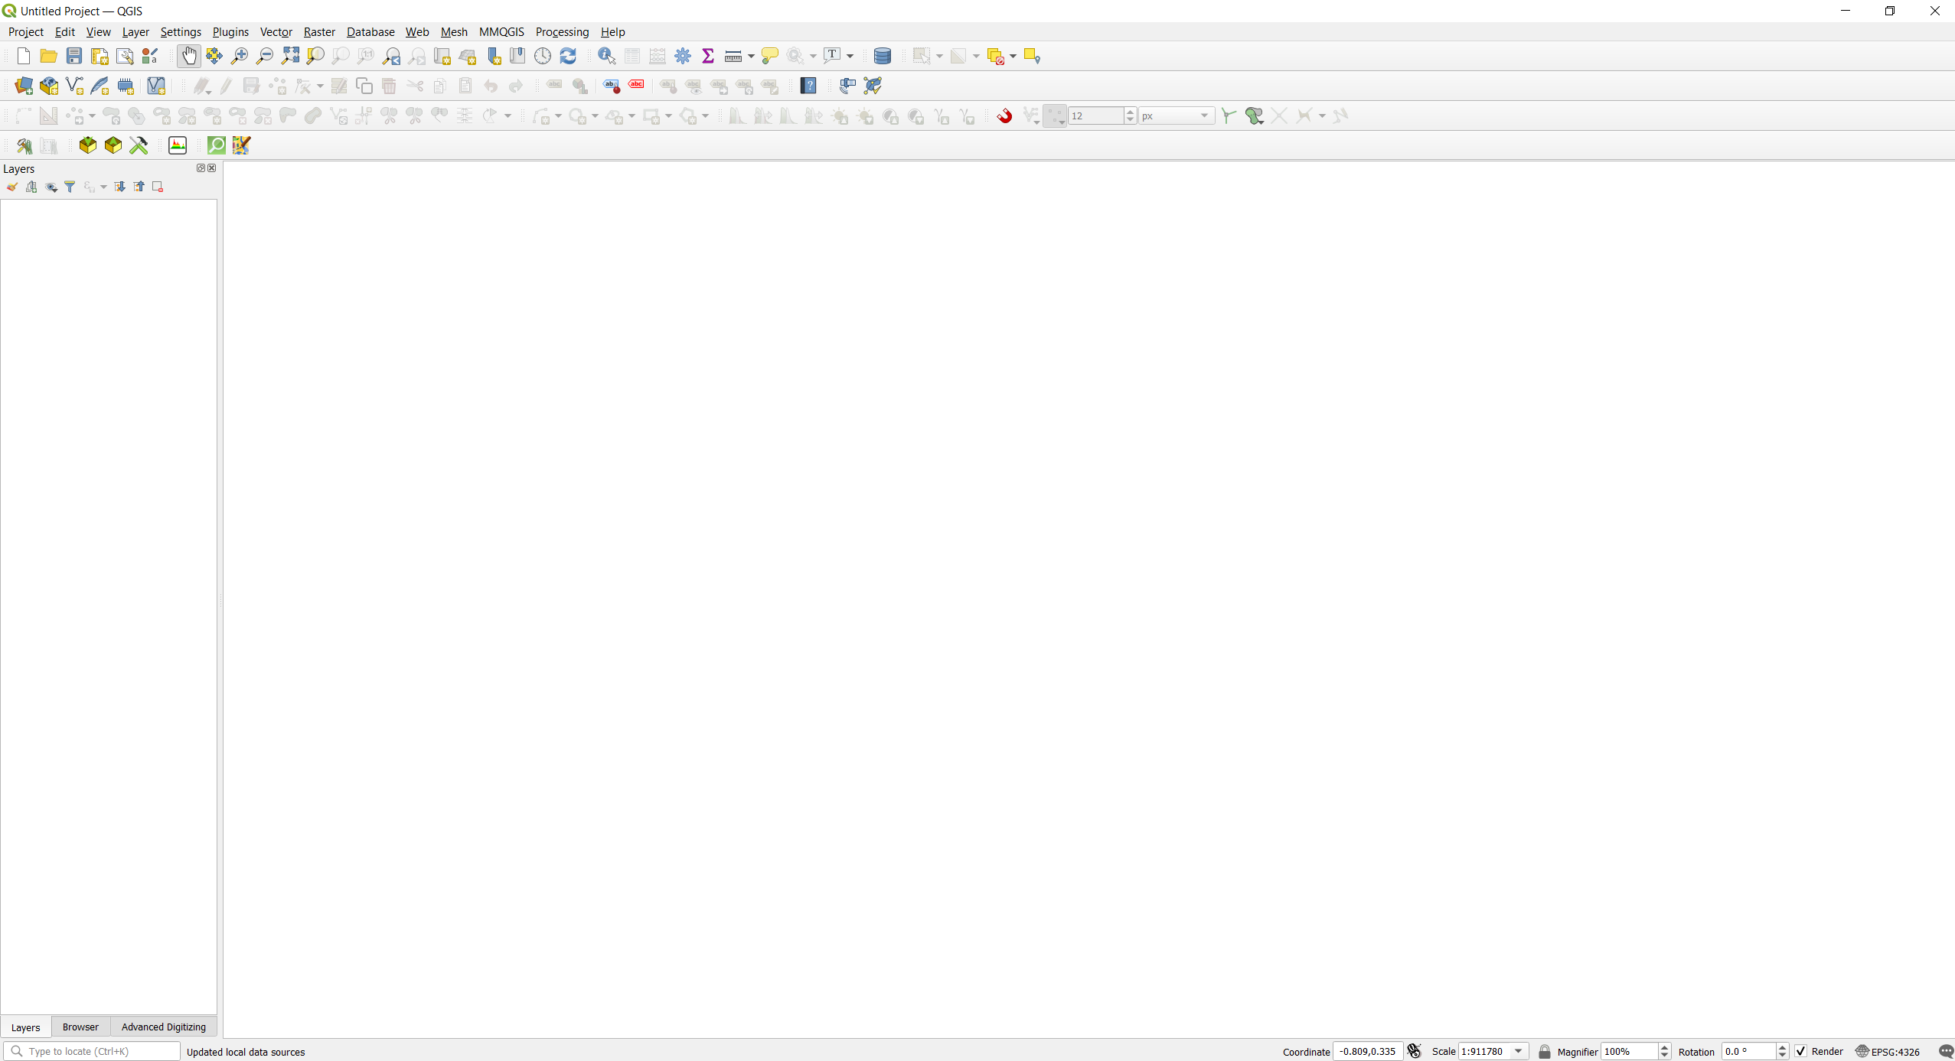
QGIS Interface
Toolbars
Panels/Layers List
Map Canvas

Slide 15
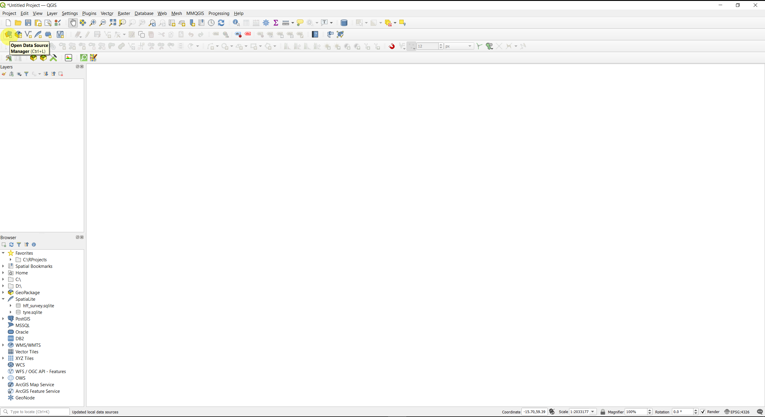
Load Data - Vectors
Click on “Open Data Source Manager”

Slide 16
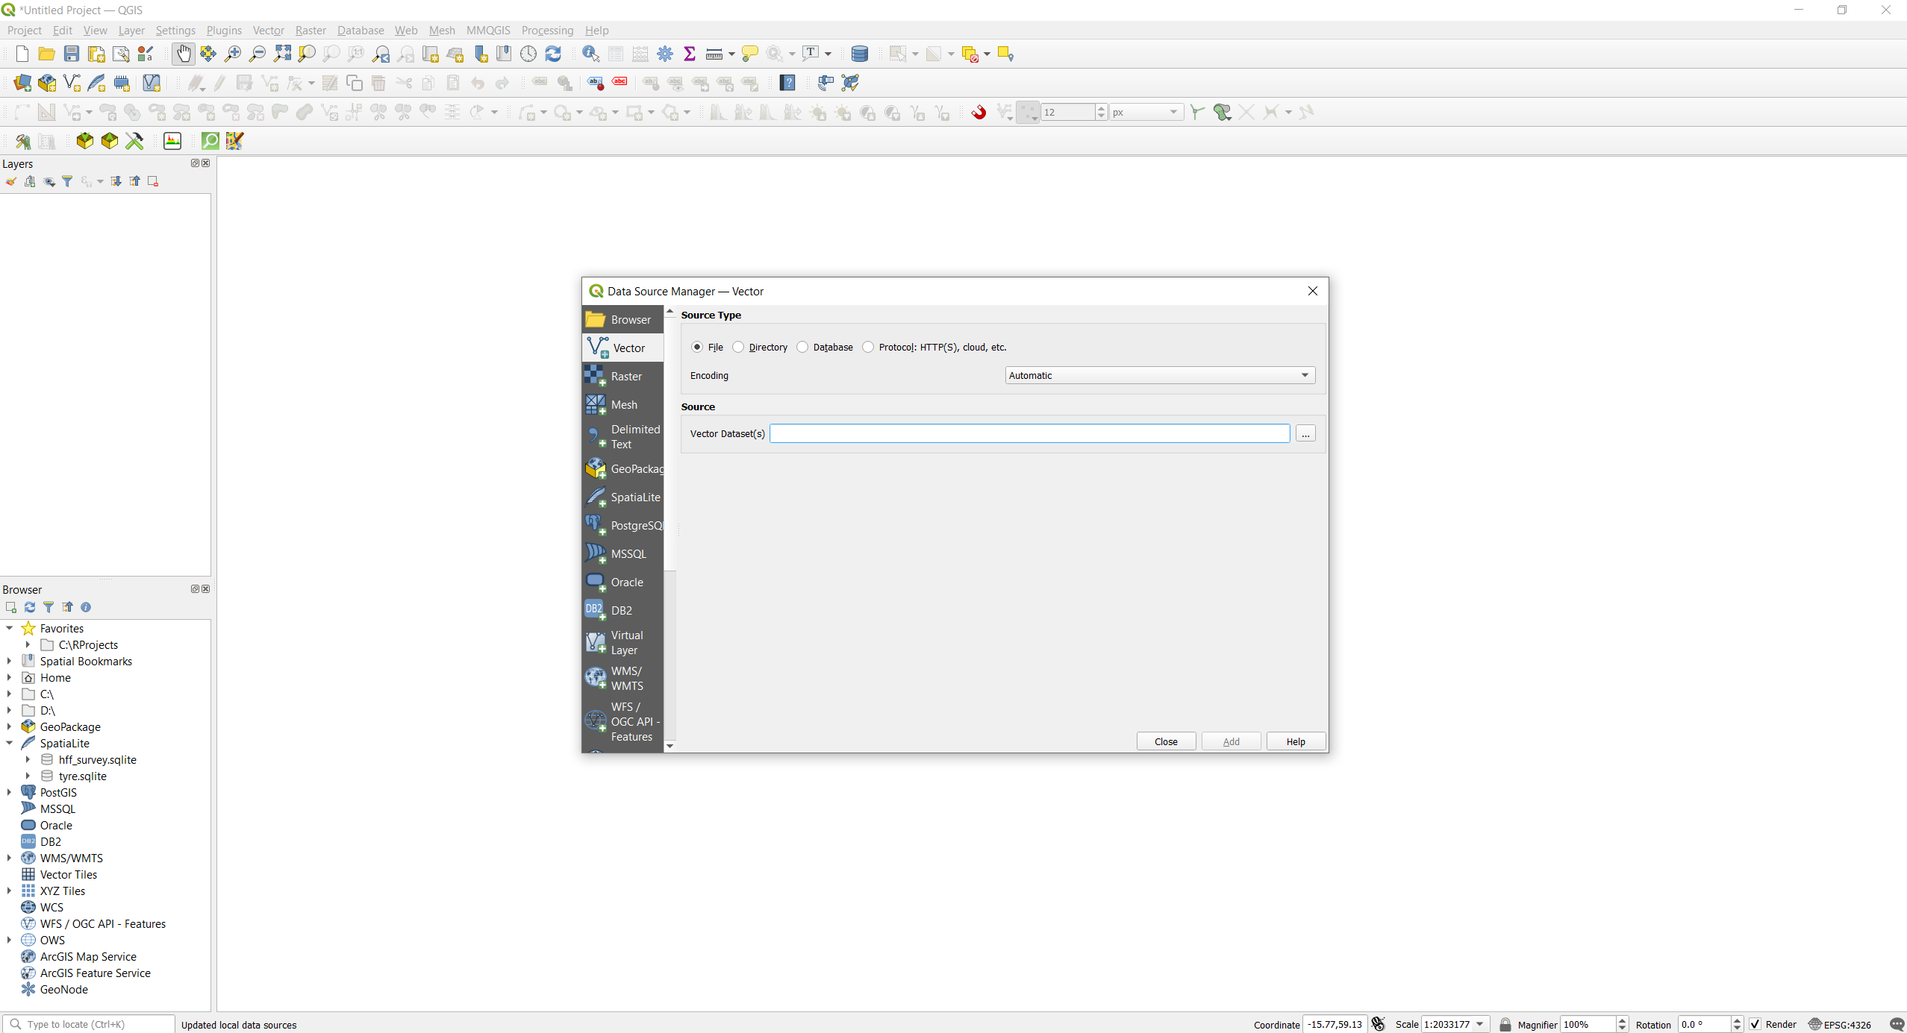
Load Data - Vectors
We have to tell QGIS which kind of data we want to load, this is why is important to know the differences we saw before.
Select “Vector” from the list from the left -> Source Type select “File” -> Click on the three dots under the “Source” menu
1
2

Slide 17
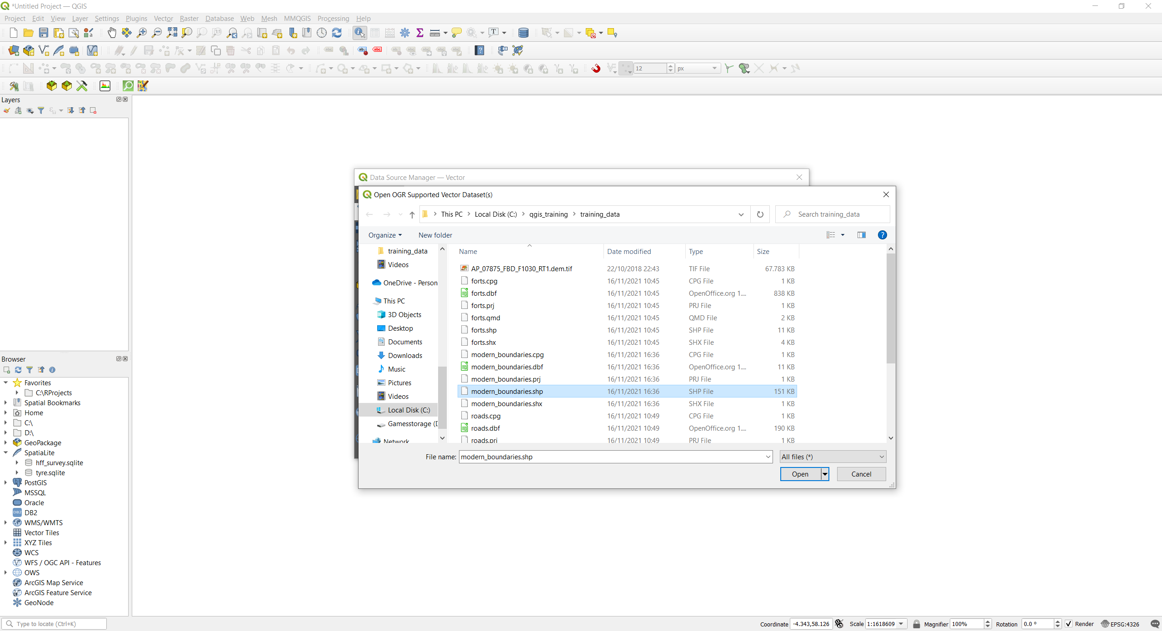
Load Data - Vectors
Navigate to the “training data” folder, scroll down and select the “modern_boundaries.shp” file from the list of files. Once select it, click on “Open”
Before clicking “Open”, take a moment to observe the data named “modern_boundaries”. With any .shp file data there are at least two/three mandatory files that must rest in the same folder as the main .shp file (.shx, .dbf, .prj). All these ensures that the vector is displayed and located currently on the map canvas. The .prj file (responsible for storing metadata for the projection systems used by the vector) sometimes is omitted.
Shapefile data structure
Mandatory:
.shp -> main file
.shx -> index file
.dbf -> database file
.prj -> projection file
Optional:
.xml -> metadata
.sbn -> optimizing file
.sbx -> optimizing file
1
2

Slide 18
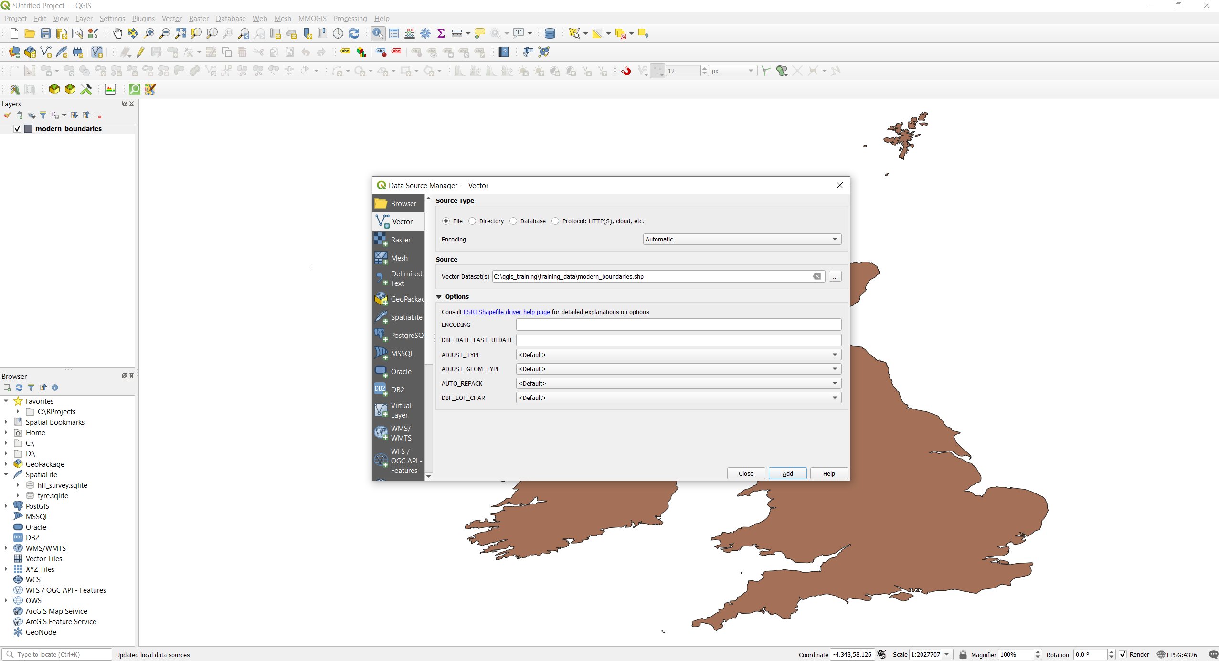
Load Data - Vectors
Leave every option as it is, and click on the “Add” button. You should now see that a new entry has appeared under the “Layers” panel to the left.

Slide 19
Load Data - Vectors
We can load other data as well. Click again on the three dots under the “Source” menu

Slide 20
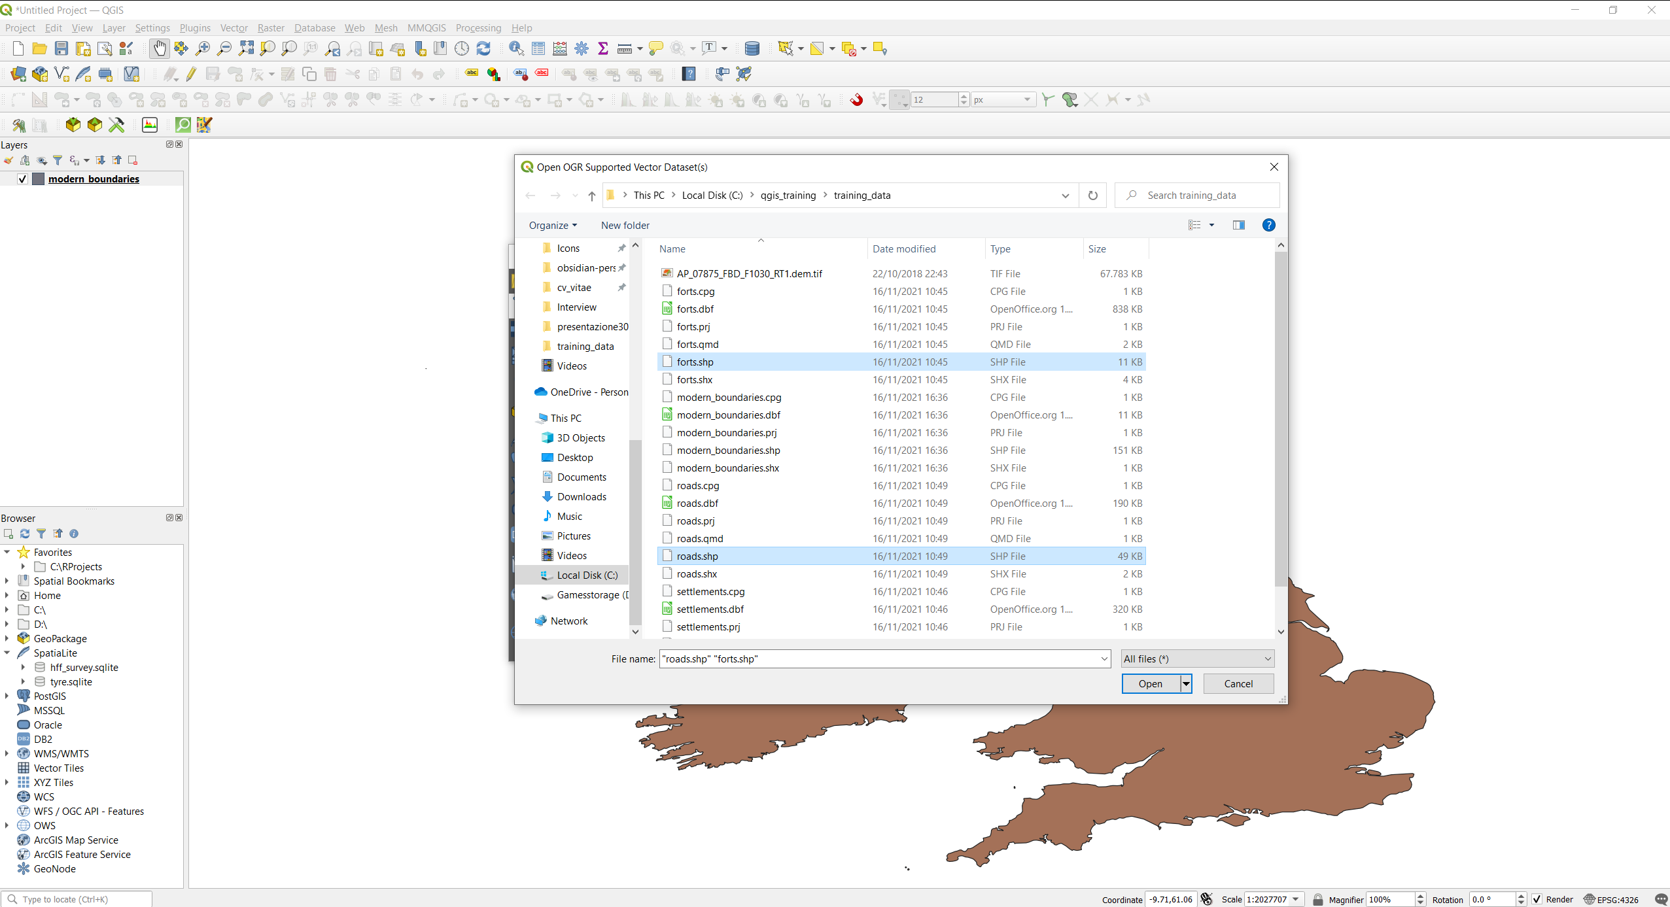
Load Data - Vectors
We can load multiple data together. On the new window, select “forts.shp” and “roads.shp” by holding down ctrl/control (on a Mac hold down cmd/command) and click “Open” once again.
1
2
3

Slide 21

Load Data - Vectors
Click on “Add” once again and you should see two new entries in the layer panel to the left.
Now we can close the data source manager windows by either clicking “Close” or the X on the top right corner.
Note how each layer on the left in the Layers panel is represented by a different symbol. QGIS is basically telling you what kind of geometries these layers are (we have seen these before, vectors can be either points, lines, or polygons).

Slide 22
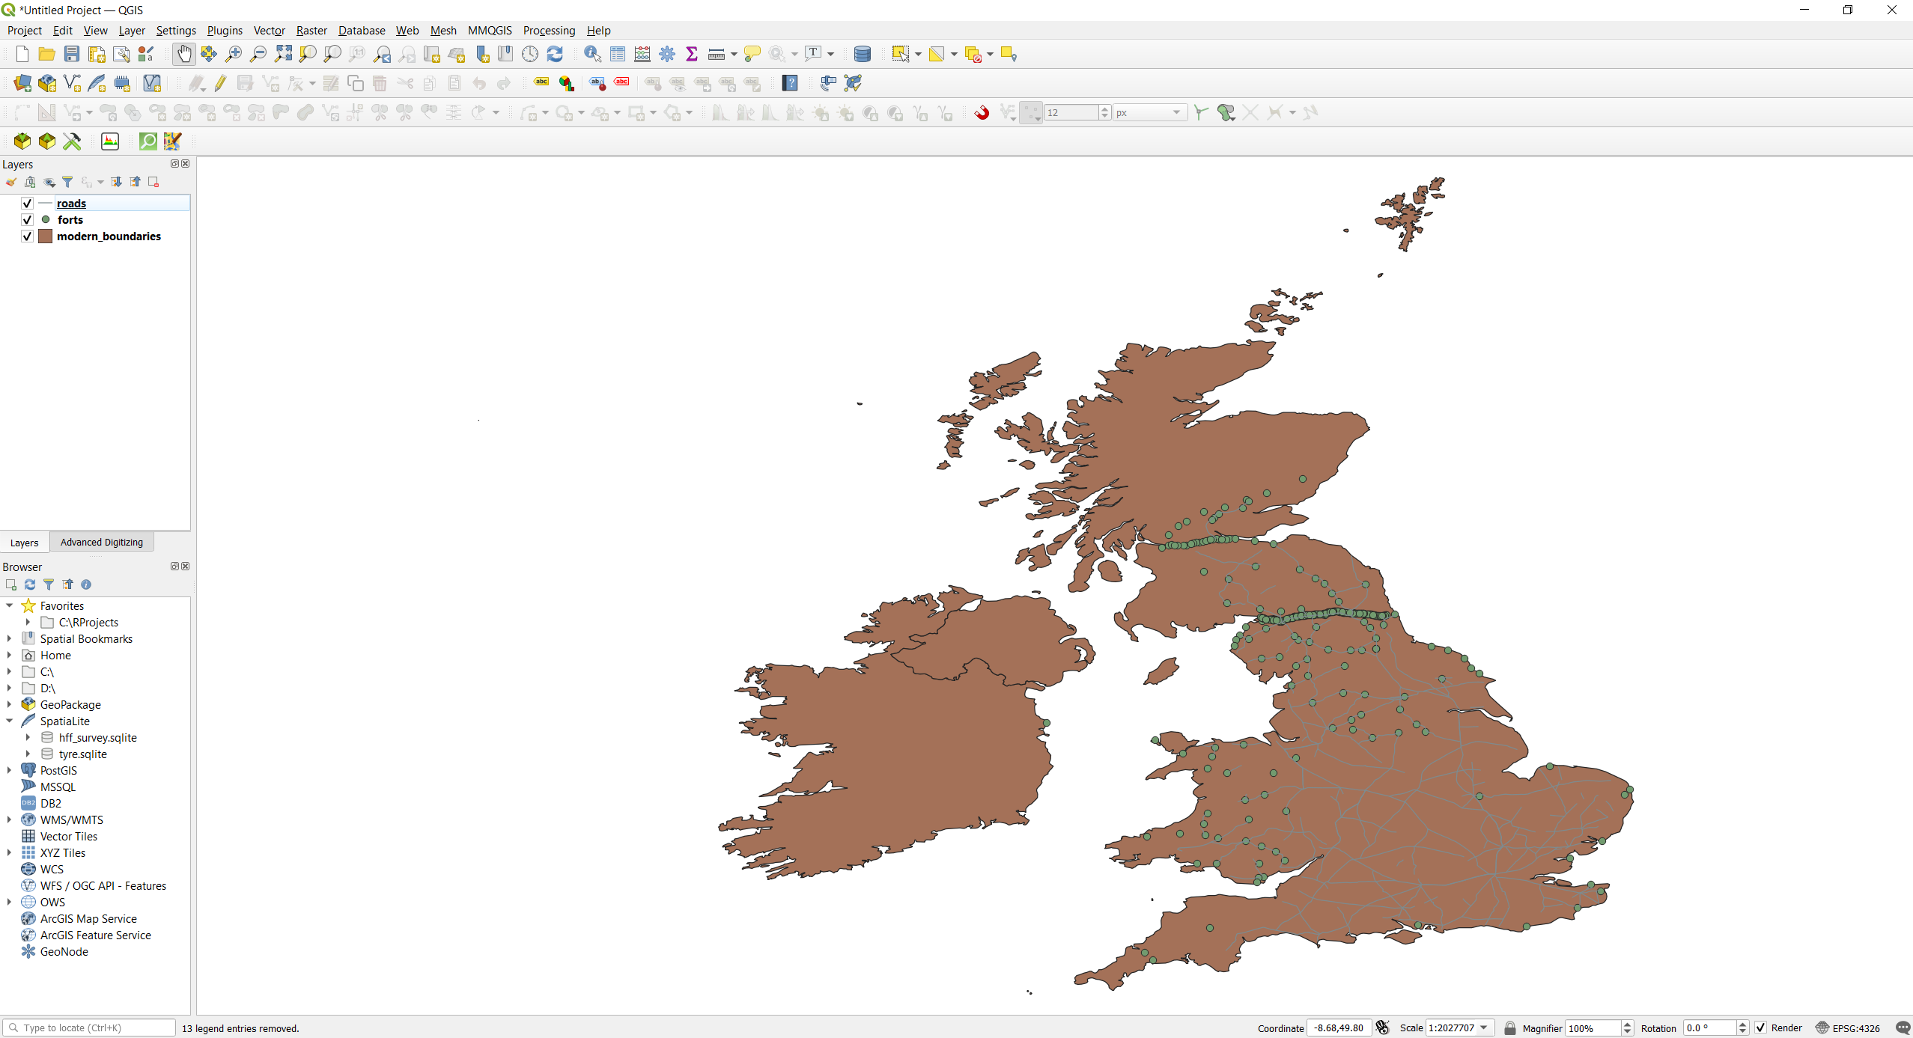
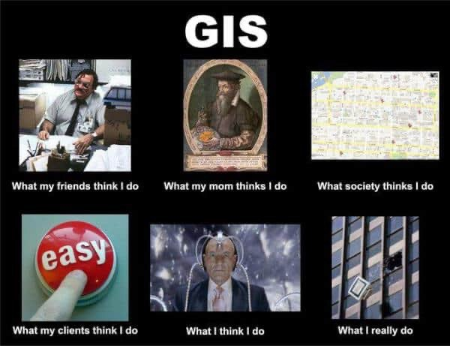
Save often!
It is normal behaviour for most GIS softwares to sometimes hang or crash. To prevent this, be sure to save often.
To save a project in QGIS, click the “Save” button, it is the floppy disk button at the top of the toolbar, right under “Edit”.

Slide 23
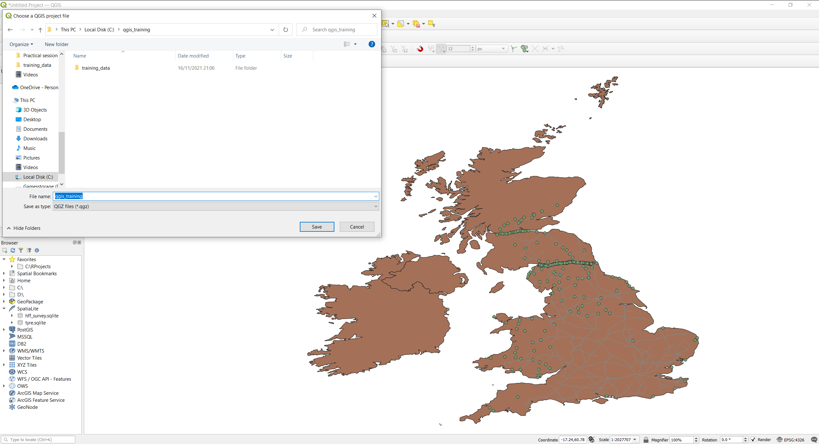
Save often!
A new window should open, select where to save your project (best practice: avoid saving to your desktop), give it a name (e.g. qgis_training), leave other options as they are and click “Save”. (Tip: avoid saving to your Desktop, it can sometimes break links withing qgis with more complex projects)

Slide 24
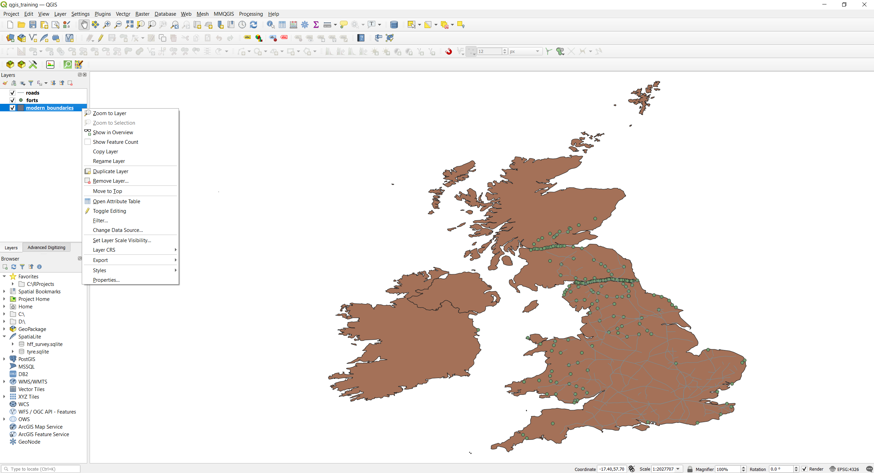
Moving around the map
Note how the name of the project on the top left is now changed as well. Now take a moment to familiarize yourself with the basic controls of the map in qgis. You can see a button shaped like a hand, this is the pane tool, select it, and you should be able to move around the map by clicking and dragging around. The same result can be achieved when holding down the middle mouse button and dragging, even when the pane tool is not selected.
To zoom in, use the mouse wheel, in order to better control the amount of zoom, you can press control on Windows an command on a Mac.
There is also a Zoom Tool that you can use (it is generally easier with the mouse wheel). The zoom tool is found on the top toolbar as the magnifying glass with a “+” or “–” sign to zoom in or out. You can drag and drop to select and area where to zoom in.
Another useful zoom tool is the Zoom to Layer tool. You can find it by right-clicking on a layer and select “Zoom to Layer”, or at the top of your toolbar (the magnifying glass with a small white box behind it)
Zoom in or out
Zoom to Layer

Slide 25
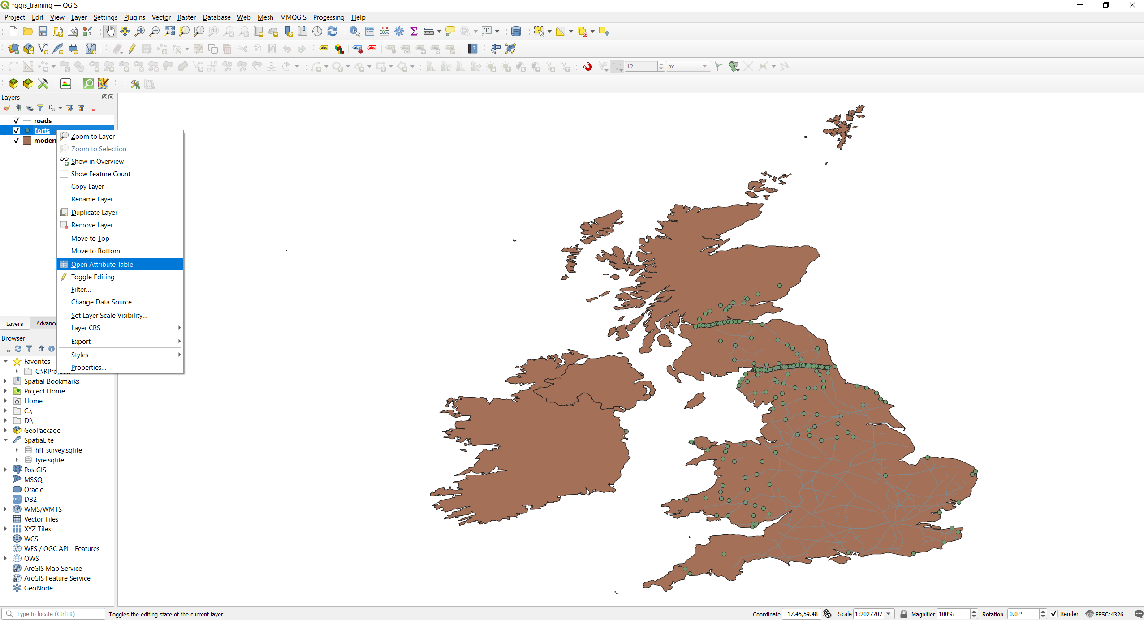
Working with Vectors – Inspect data
Now that we have our data loaded, we may want to actually take a look at the data. It is important to understand what information are stored in each data, especially if we are not the authors of those files.
Information on the data are stored, as said before, as attributes, which translates in QGIS into as an attribute table, unique for each layer, that we can open and inspect.
You can do that by right clicking on a layer of choice, e.g. forts, and select “Open Attribute Table”, in the middle of the popup window.
Open Attribute Table Tool
1. Right-click
2
Another way of opening the attribute table is by clicking the “Open Attribute Table” tool in the toolbar on top, which is symbolized by a sort of table.

Slide 26
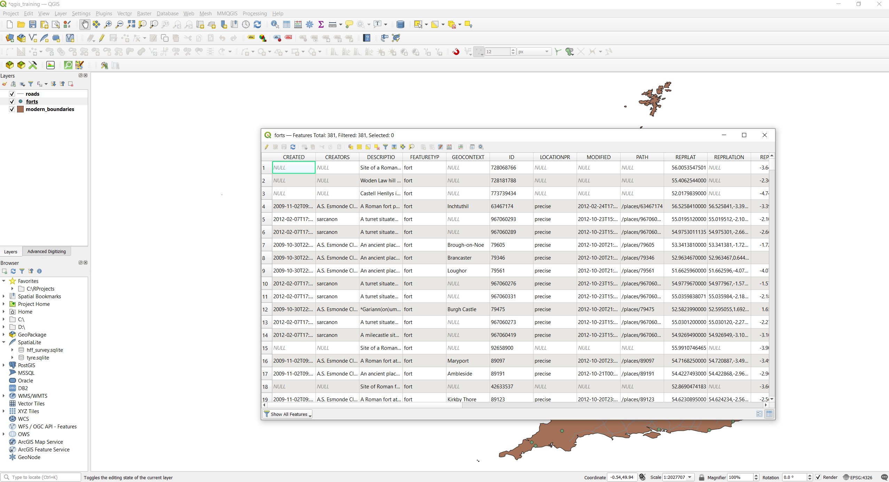
Working with Vectors – Inspect data
Now you should see a new window opening, this is the attribute table. As you can see is a sort of excel-like table, with field and info for each point or element contained inside a layer. There is also a numeric value at the very top telling you how many feature are stored in that layer (in this case, the layer “forts” have 381 features, meaning that 381 forts were recorded in that shapefile).
Information in the table are useful to both the people that created the data, and for users. For example, under FEATURETYP we can see that all our observation are listed as “forts”.
Information like this are useful when working with thousands of points and when not all of them are the same features.
We can now close the attribute table.

Slide 27
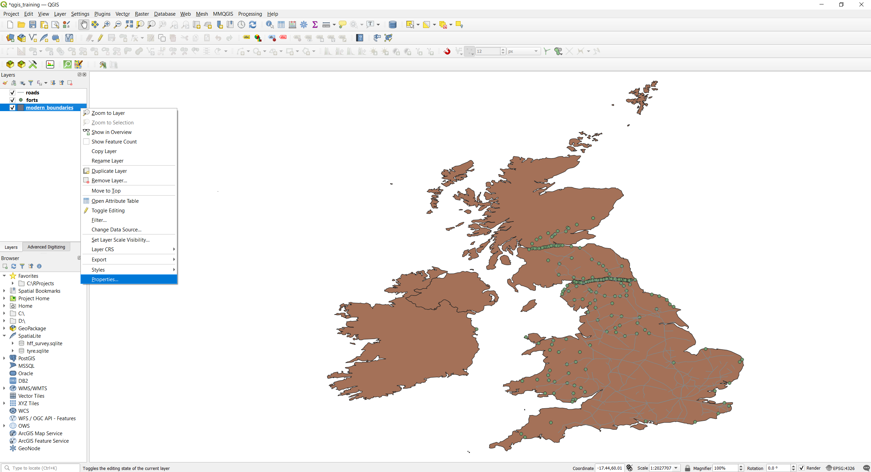
Working with Vectors – Change Layer Symbology
When working in GIS we might want to share our map with other colleagues or using it for a presentation. For the map to be effective, it must be readable. To improve readability, the first (and easier) thing to do is usually tweaking the colours of our layers.
Tip: start with your lowermost layer, or the layer that cover more of your map canvas, and then tweak the other colours accordingly.
To change colour to a layer in QGIS, you have to right click on a layer, in this case we will use “modern_boundaries” and click on “Properties” at the bottom of the pop-up window.
1. Right-click
2

Slide 28
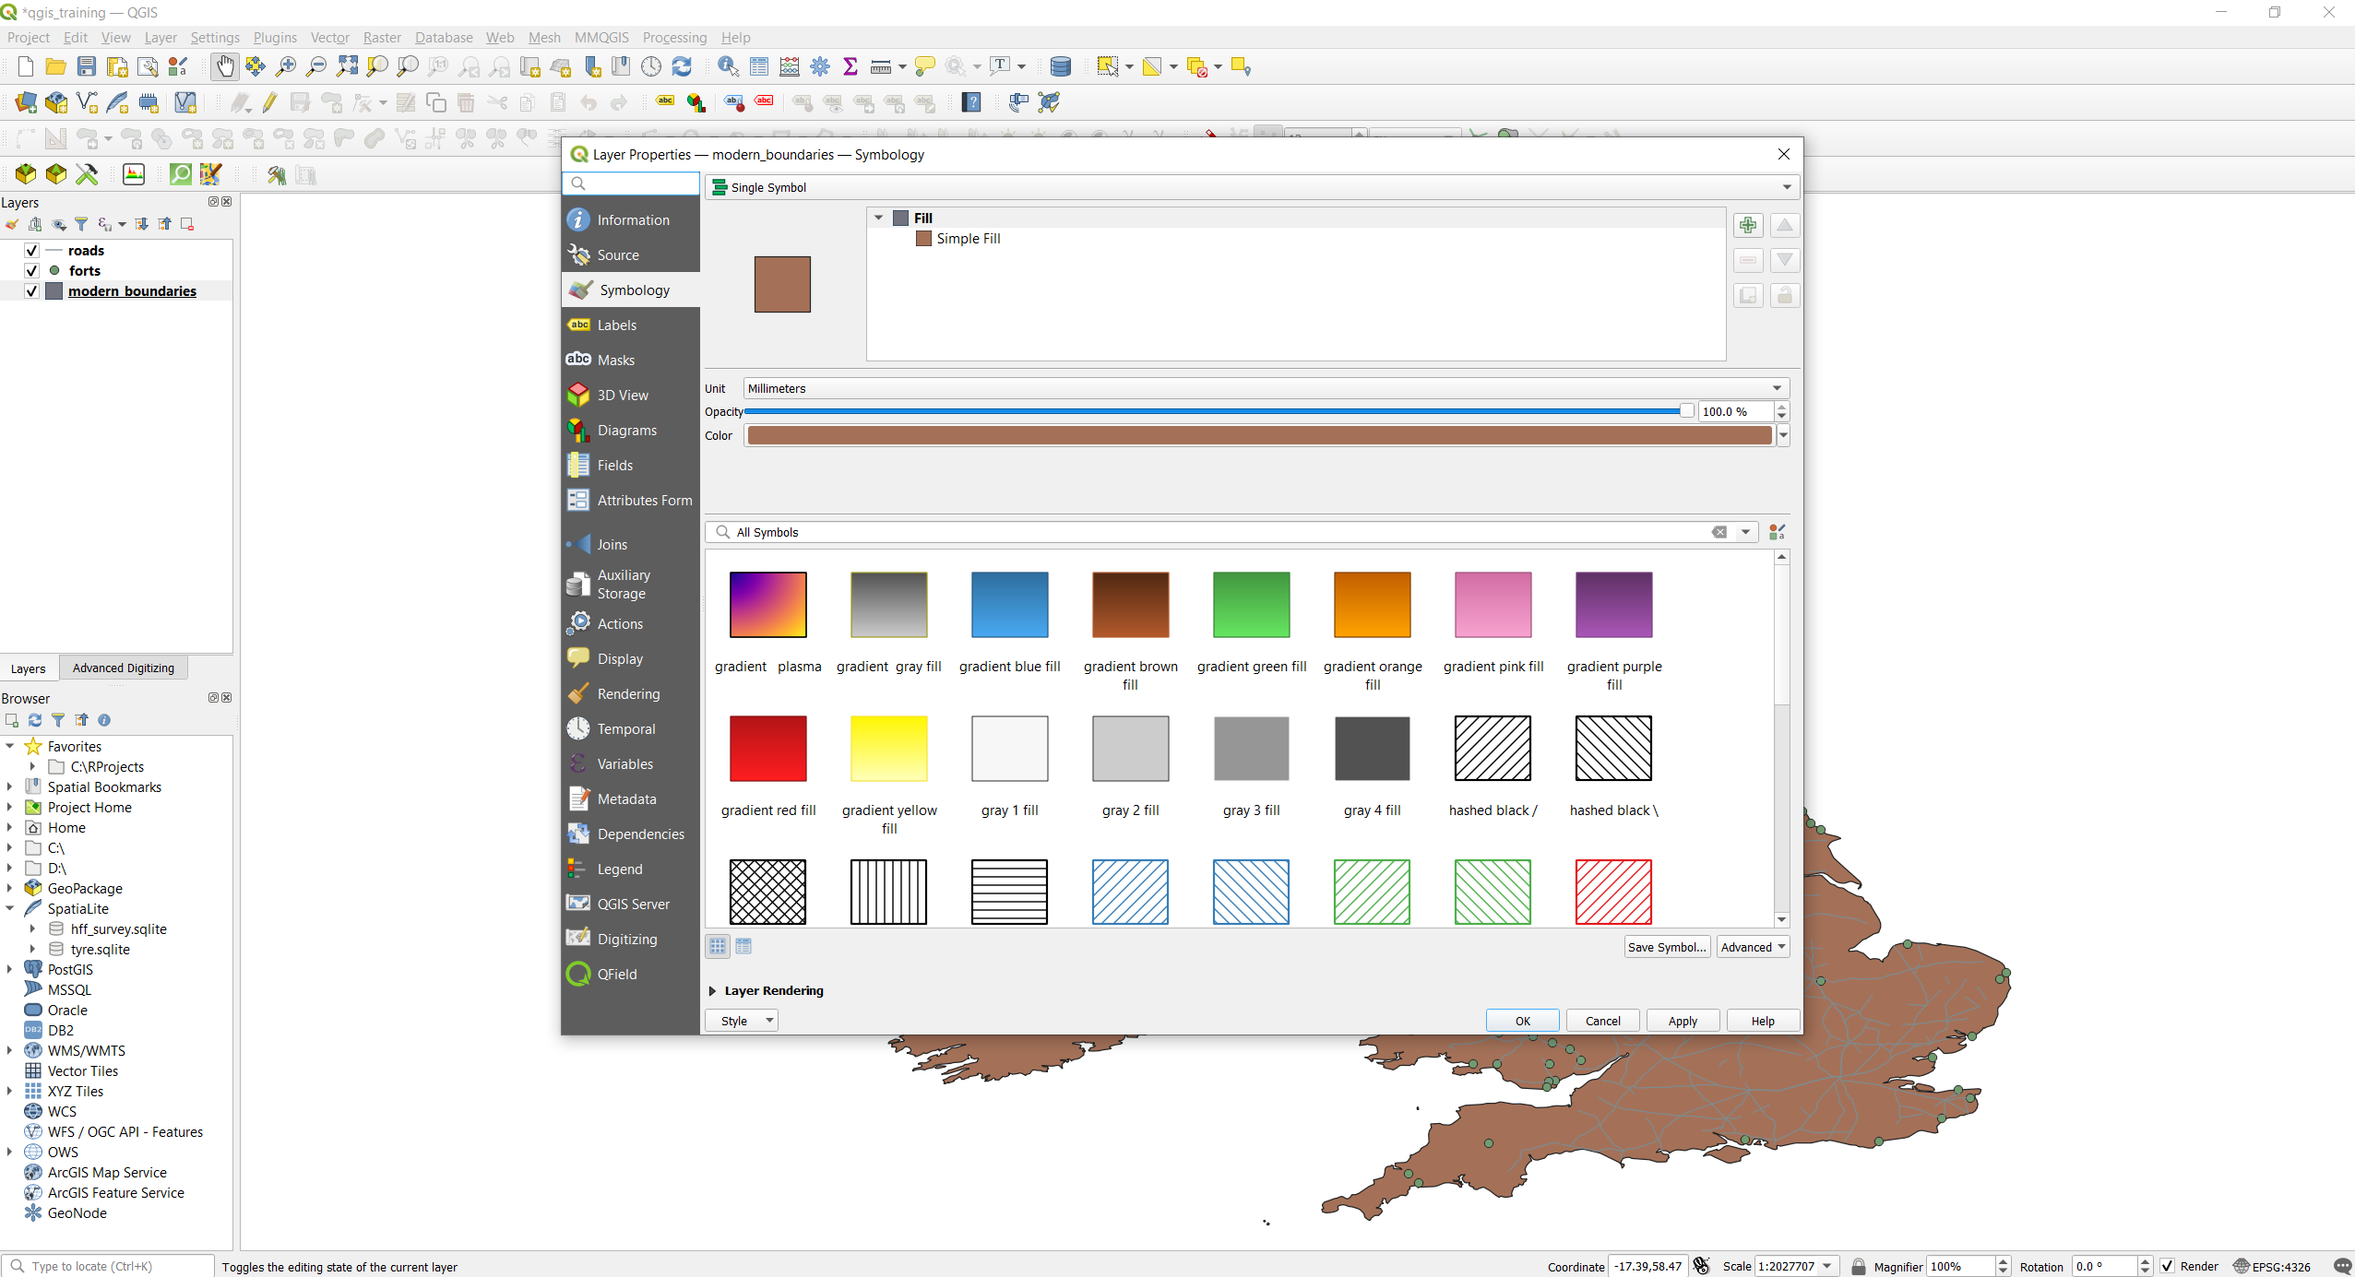
Working with Vectors – Change Layer Symbology
A new window should open, called “Layer Properties”. If it is not selected by default, select the Sybology tab on the left, under Source.
You can see now that there are a bunch of things here, but the thing we are interested now is Color, and you can find it in the upper part of the window, right under Unit and Opacity.
Now click anywhere on the colored bar.

Slide 29
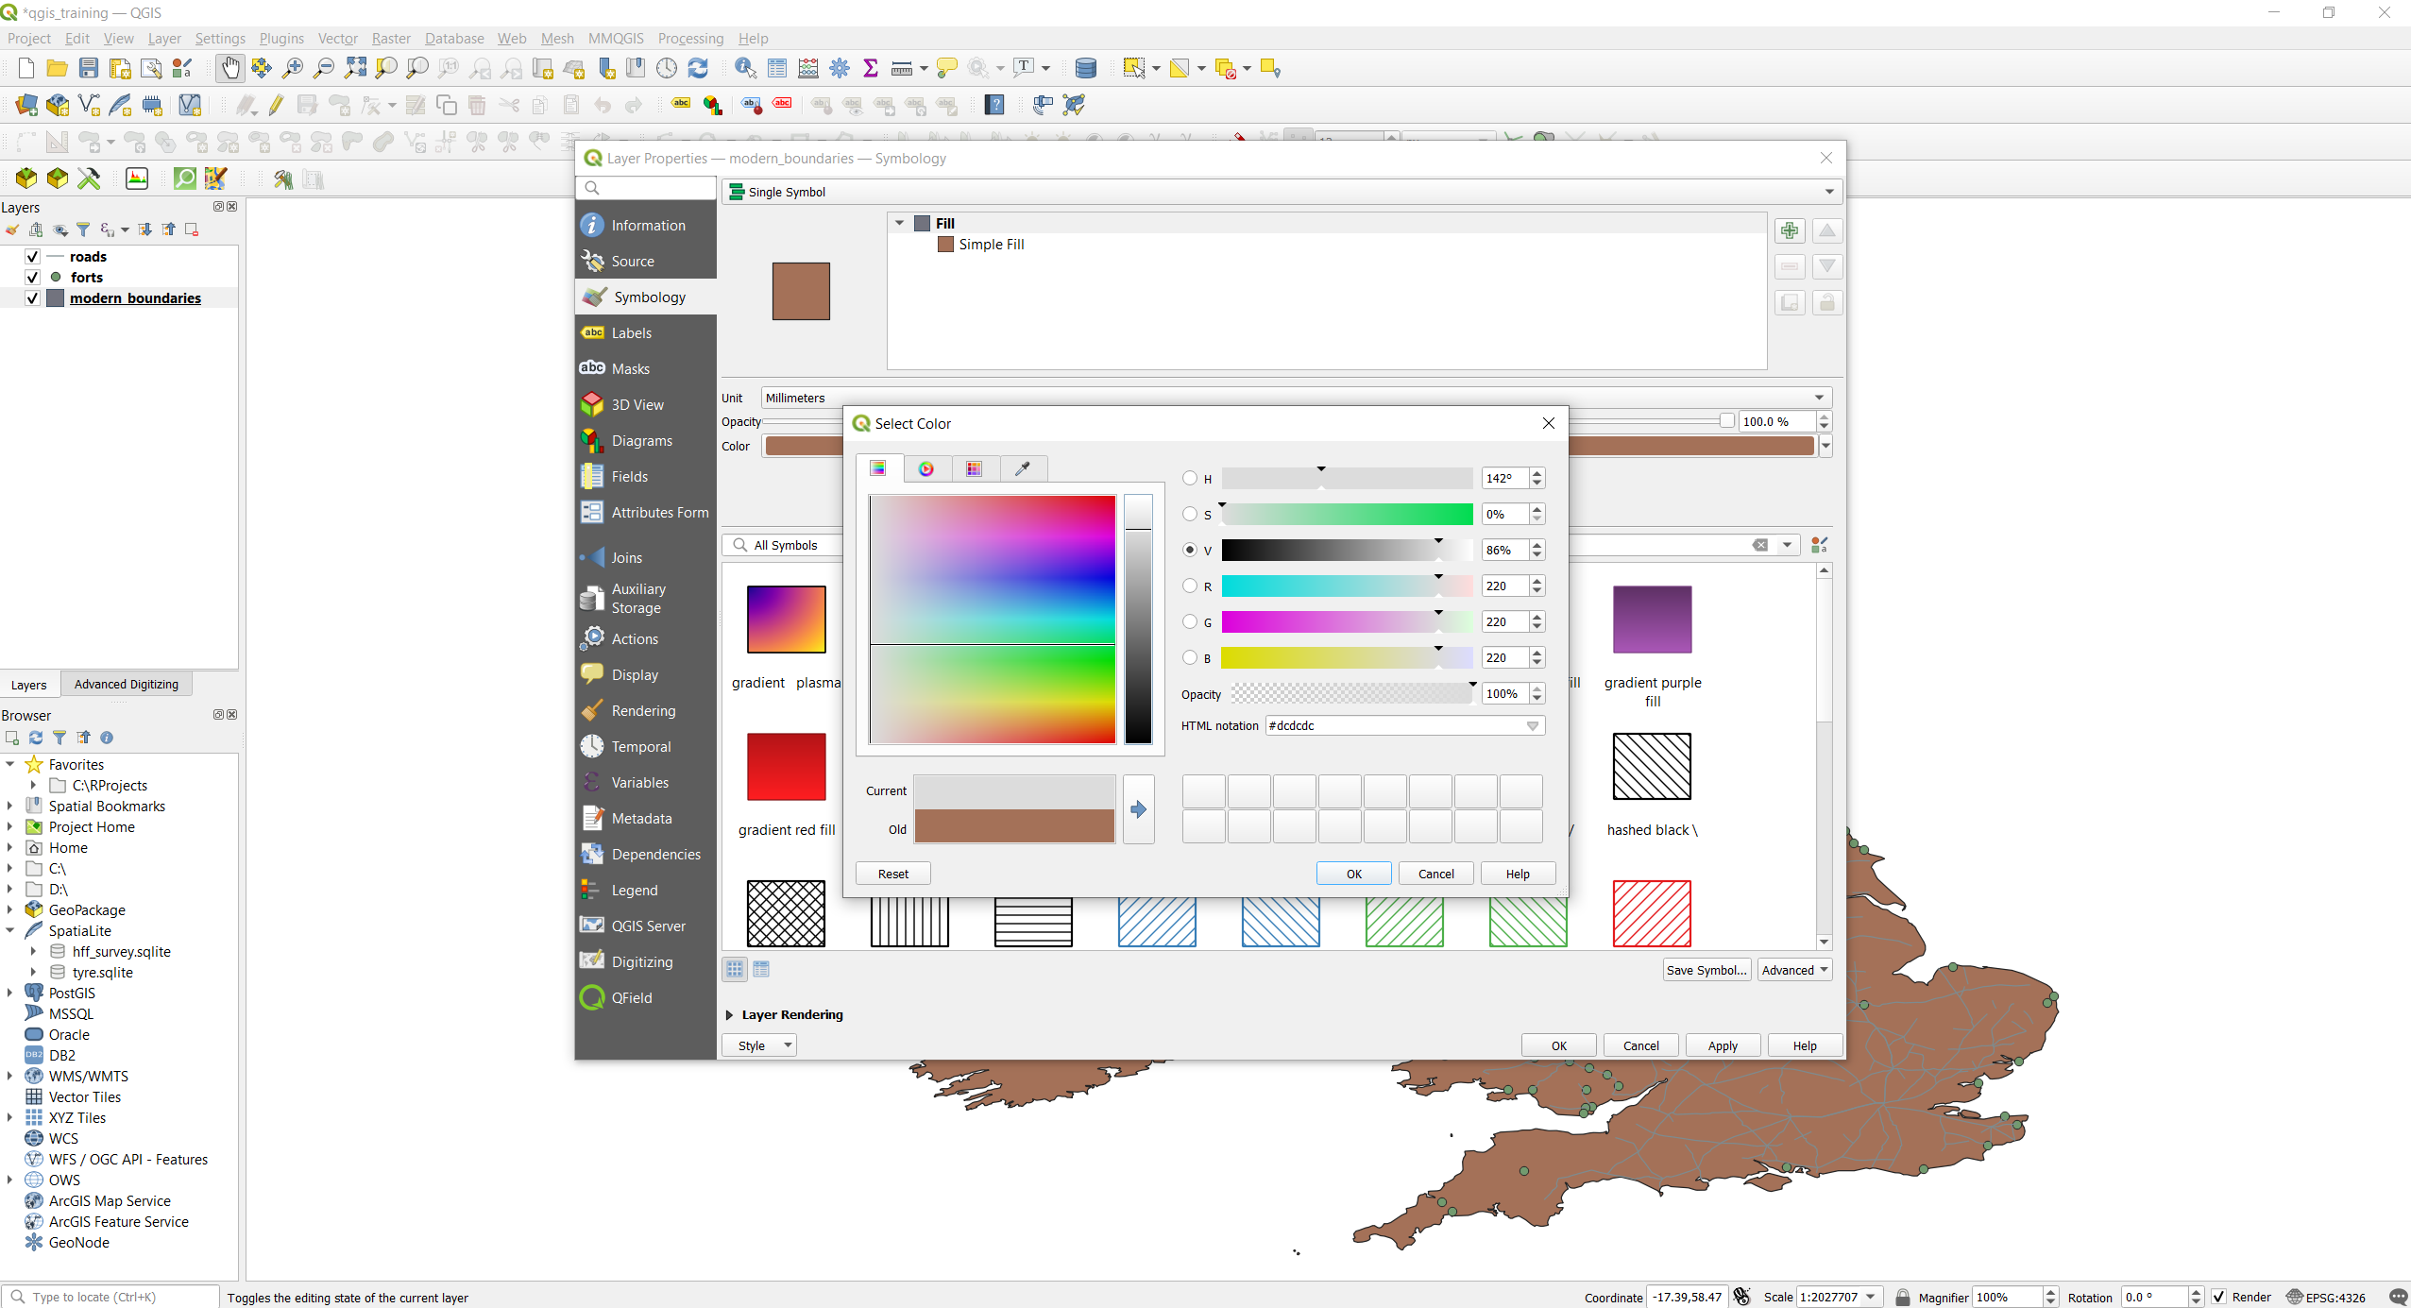
Working with Vectors – Change Layer Symbology
In the new “Select Color” window that opens, change color by dragging the crosshair in the colors square on the left and the slide on its right, or by changing any value on the bars on the right. You can also simply write an HTML value in the HTML box under “Opacity”, it is up to you!
For this presentation, I want to make the boundaries grey, so I play around with the crosshair and the slide to its right, until I get the desired result.
Once you are satisfied with the result, Select OK on this window to close it.

Slide 30
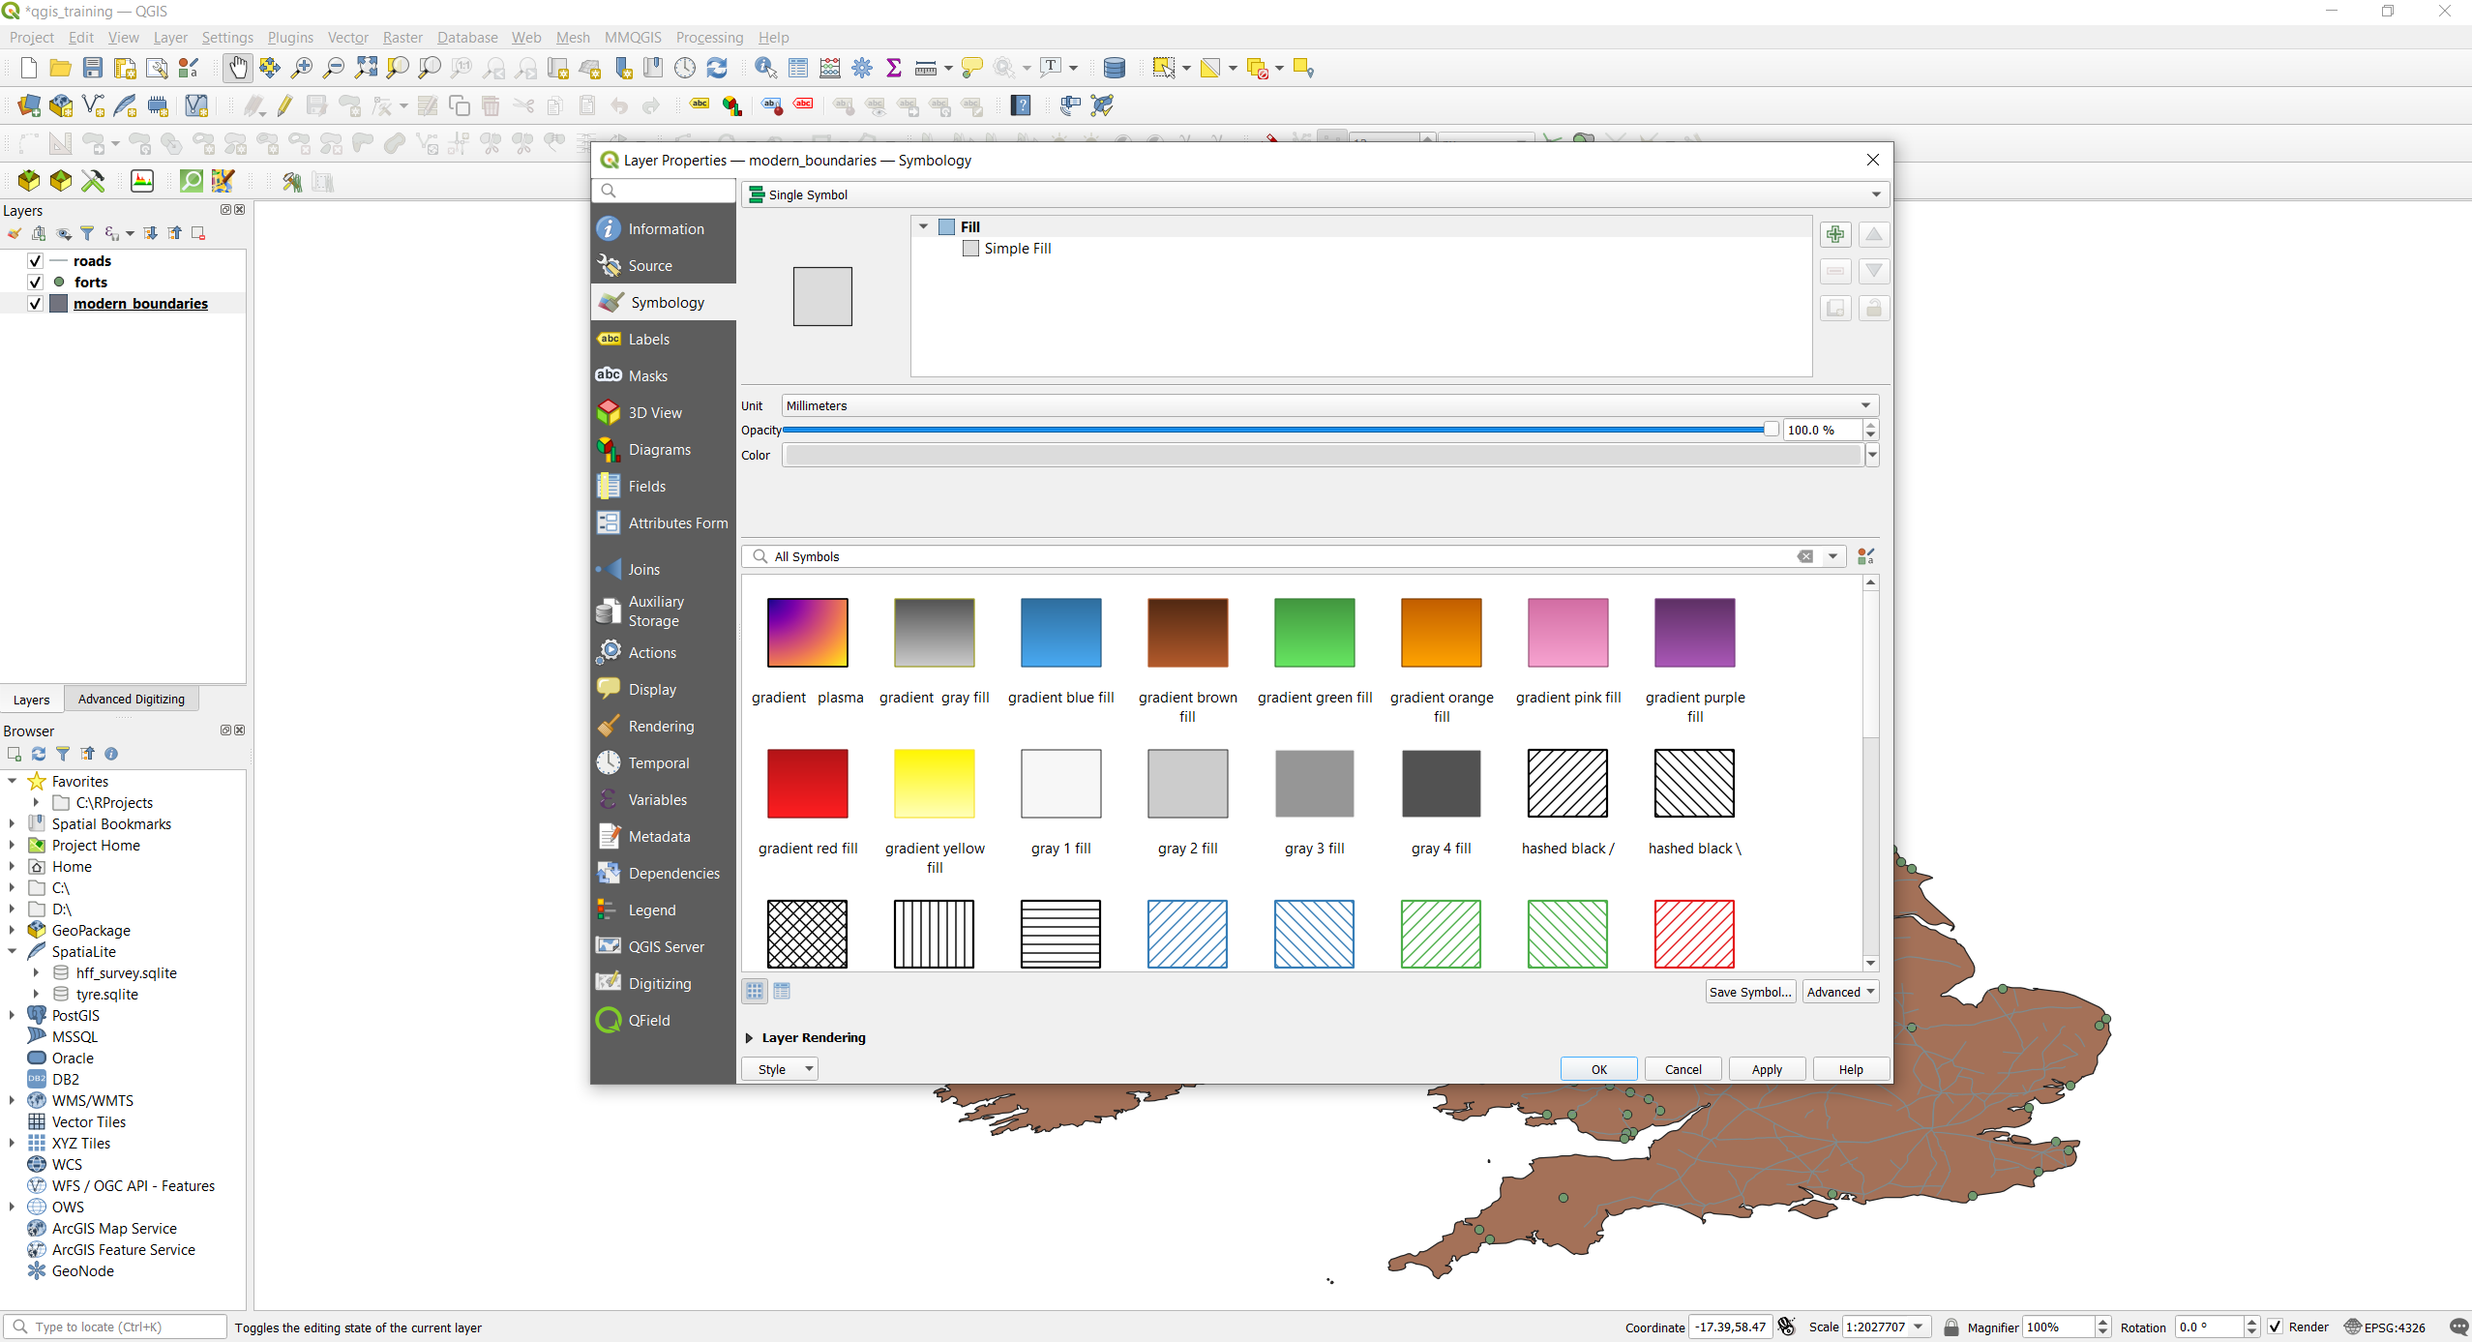
Working with Vectors – Change Layer Symbology
You can see that the colour has changed in the layer properties panel, but not on the map canvas. This is because we have not applied the modified settings yet. When you modify something, you always need to click apply for the changes to take effect.
Click now on “Apply”, and you can see that the colours on the map canvas are changed as well.
To close the Layer Properties window, simply click “OK”.
2
1

Slide 31
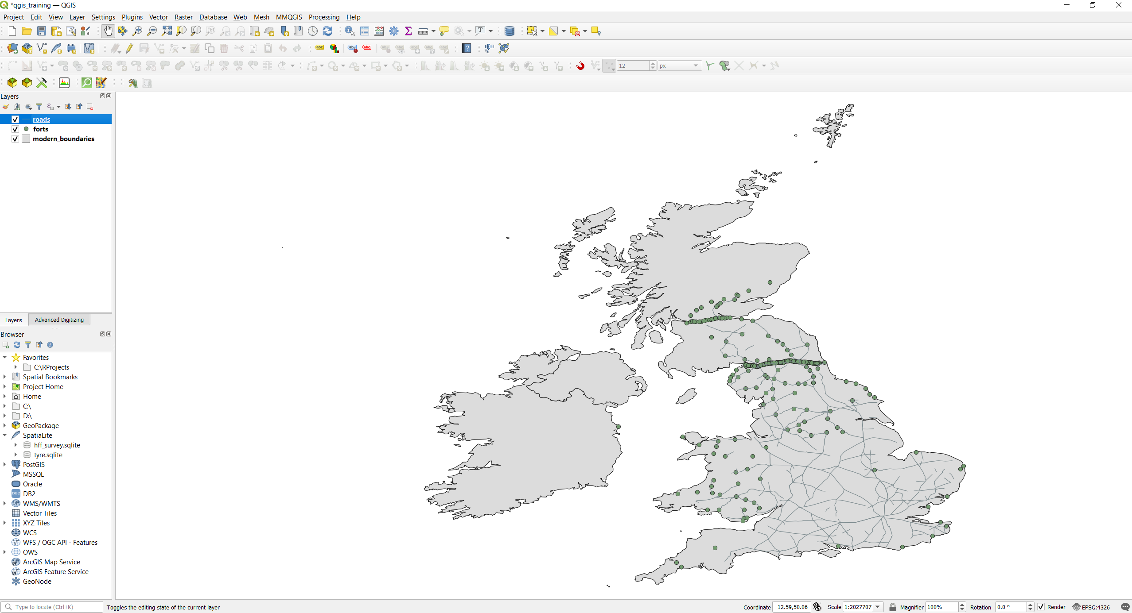
Working with Vectors – Change Layer Symbology
You can see now that all our changes have been applied and are displayed on our map canvas.
We can do the same things to our roads, so that they contrast better with the grey background.
To open the Layer Properties panel in a faster way, instead of right-clicking, we can double-click on the layer name in the layers panel.
Double-click

Slide 32
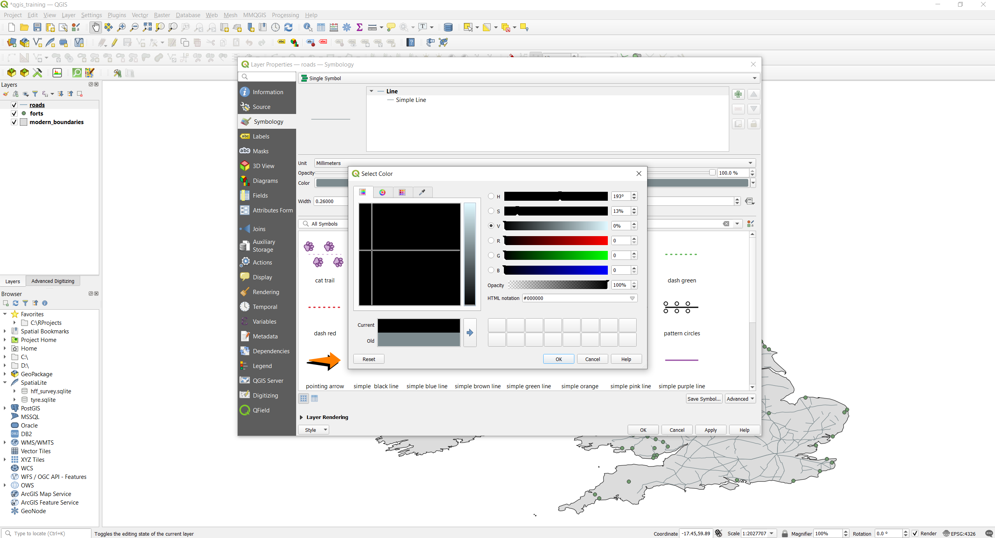
Working with Vectors – Change Layer Symbology
We can change the colour of the roads in the same way we did with the boundaries. Click on the colour bar to open the “Select Color” window, and then select a color that fits well for you, in this case I will choose a black color to improve contrast.
After selecting the colour, as before, click OK to close the Select Color window, and then click Apply.
After that, close the Layer Properties by clicking OK.
1
2
3
4

Slide 33
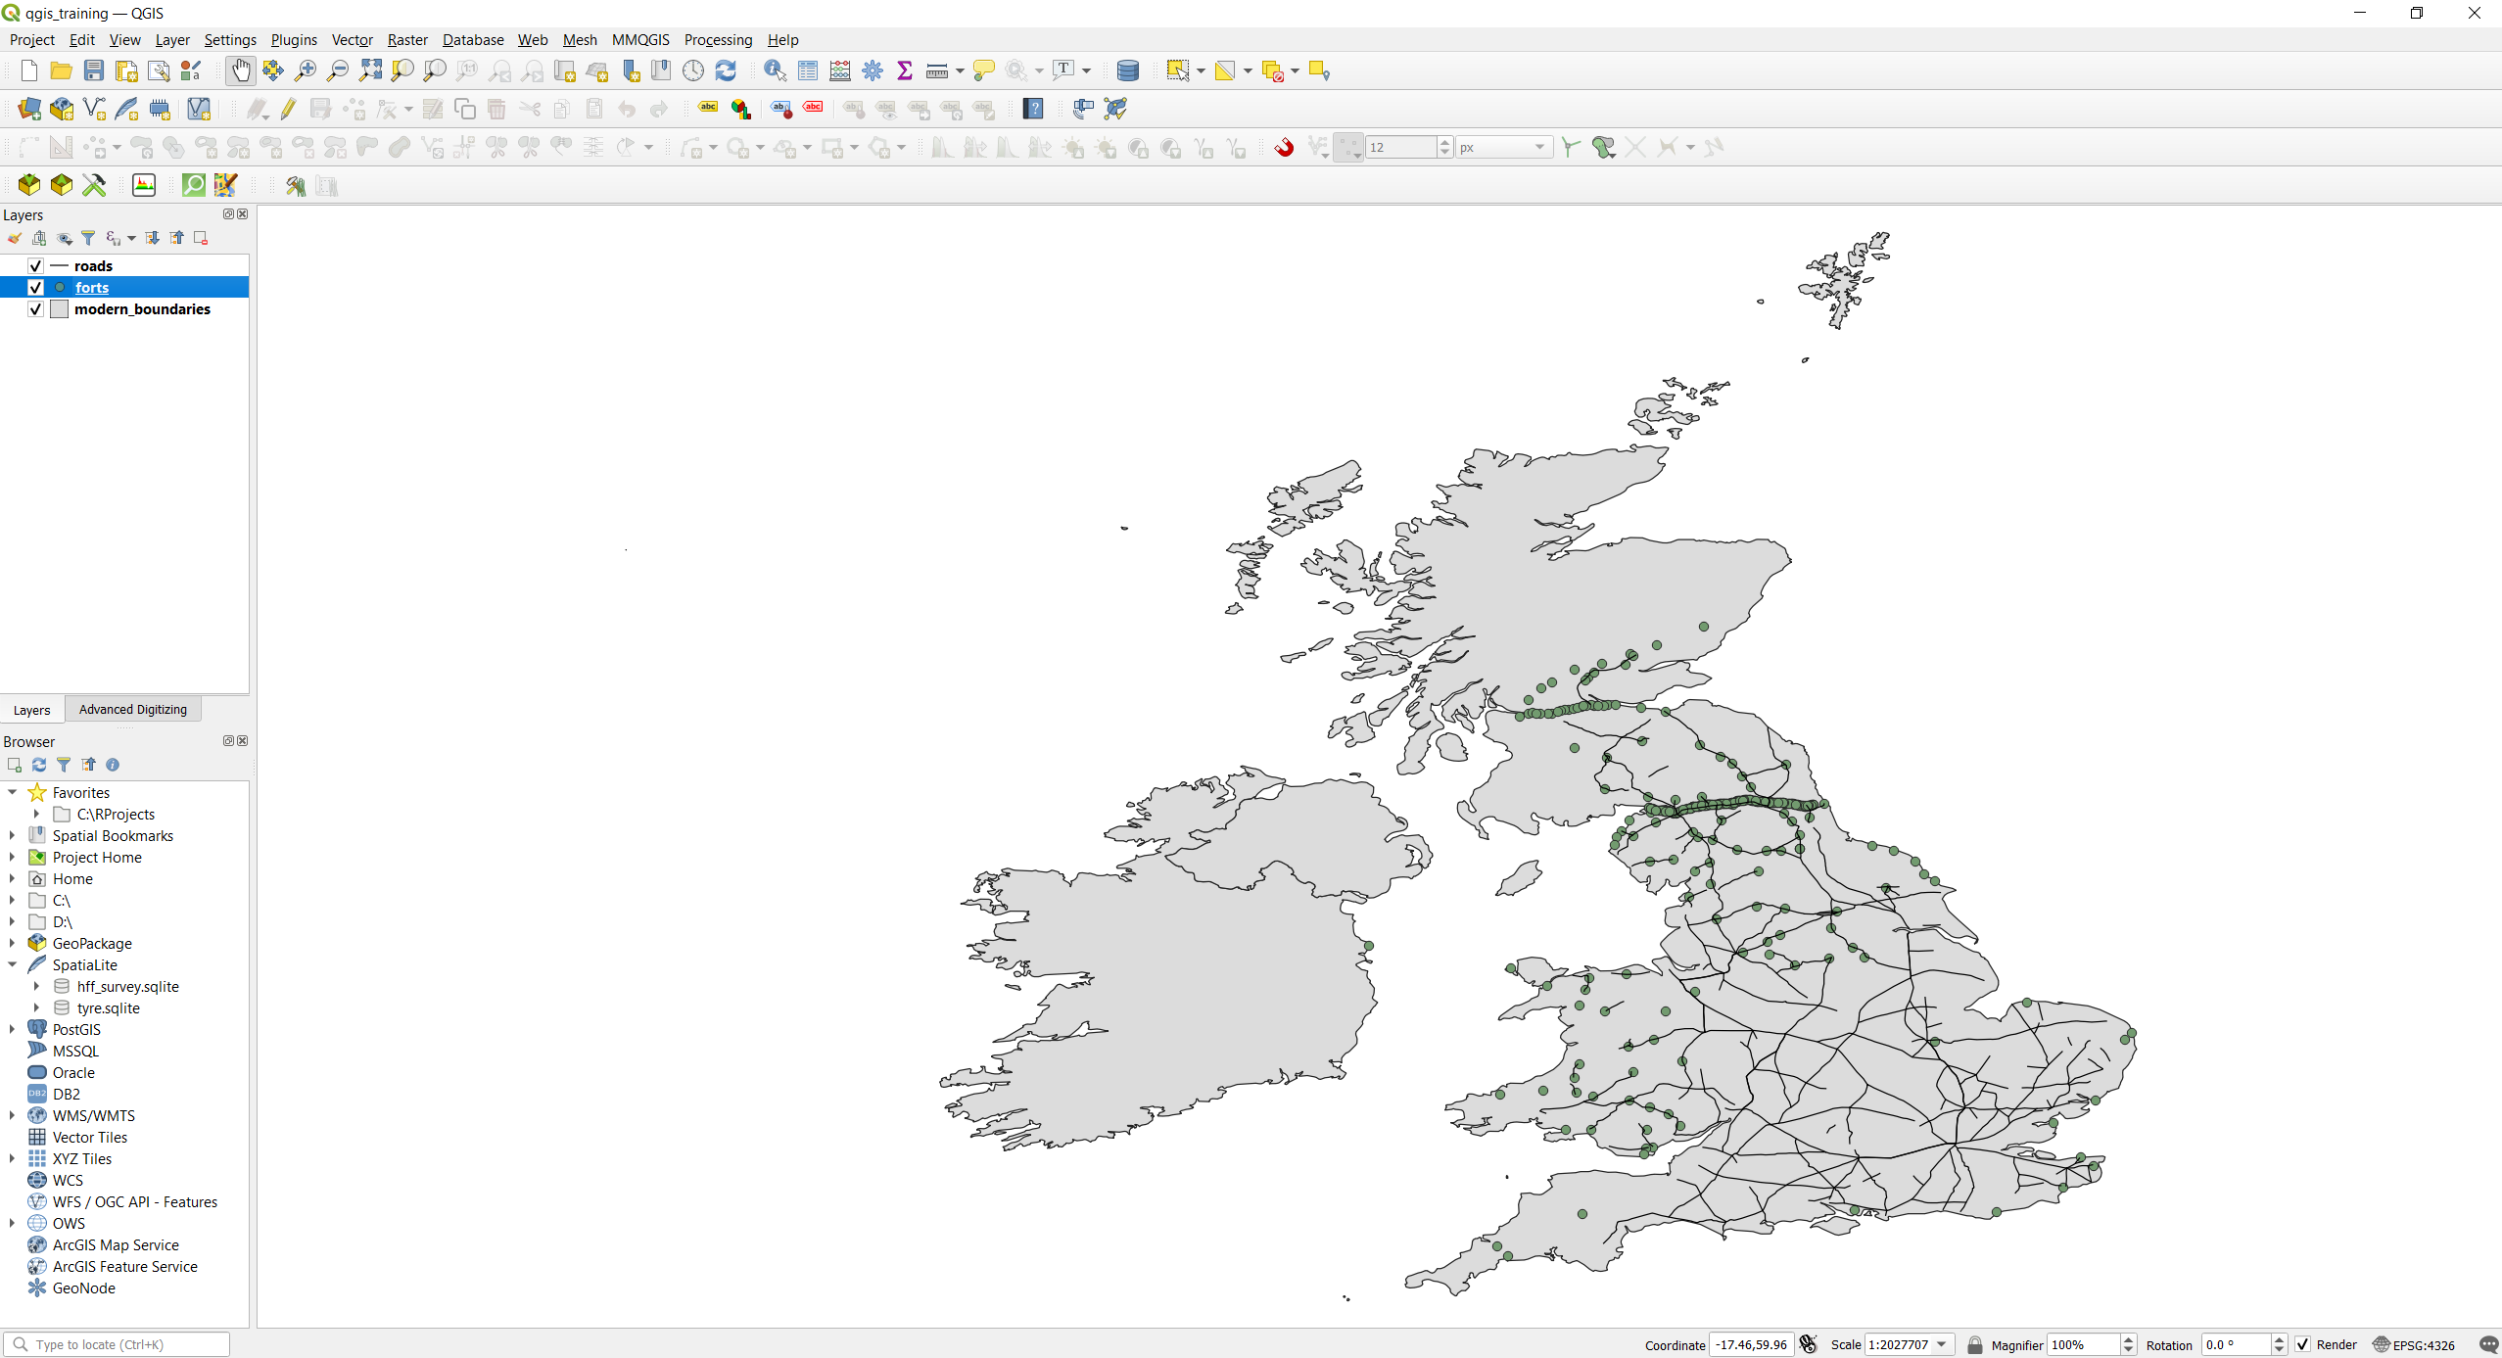
Working with Vectors – Change Layer Symbology
Just to be sure, save your project (click on the floppy disk symbol on the top left of the toolbar).
Another thing that we can do to improve readability, is to change the shape of a layer, so that is not a generic set of points, but it is immediately recognizable at first sight (this might be useful for example when you have a lot of layers to distinguish).
Double-click on the forts layer in the Layers Panel.
Double-Click

Slide 34
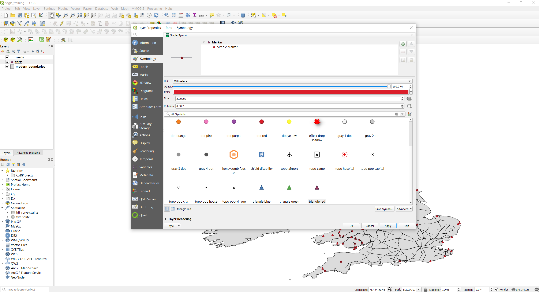
Working with Vectors – Change Layer Symbology
In the Layer Properties window, we don’t want to change color now, but you can see that at the very bottom there is a panel with different symbols inside it.
We can scroll down in this panel and select a for example the small square shape called “triangle red” at the bottom of the panel.
We should also change the size of the symbol so that it is not too big, and it does cover other features too much.
To do that, change the value in the “Size” box, right under the colour bar.
2
We can now click apply and OK to close the window.
1

Slide 35
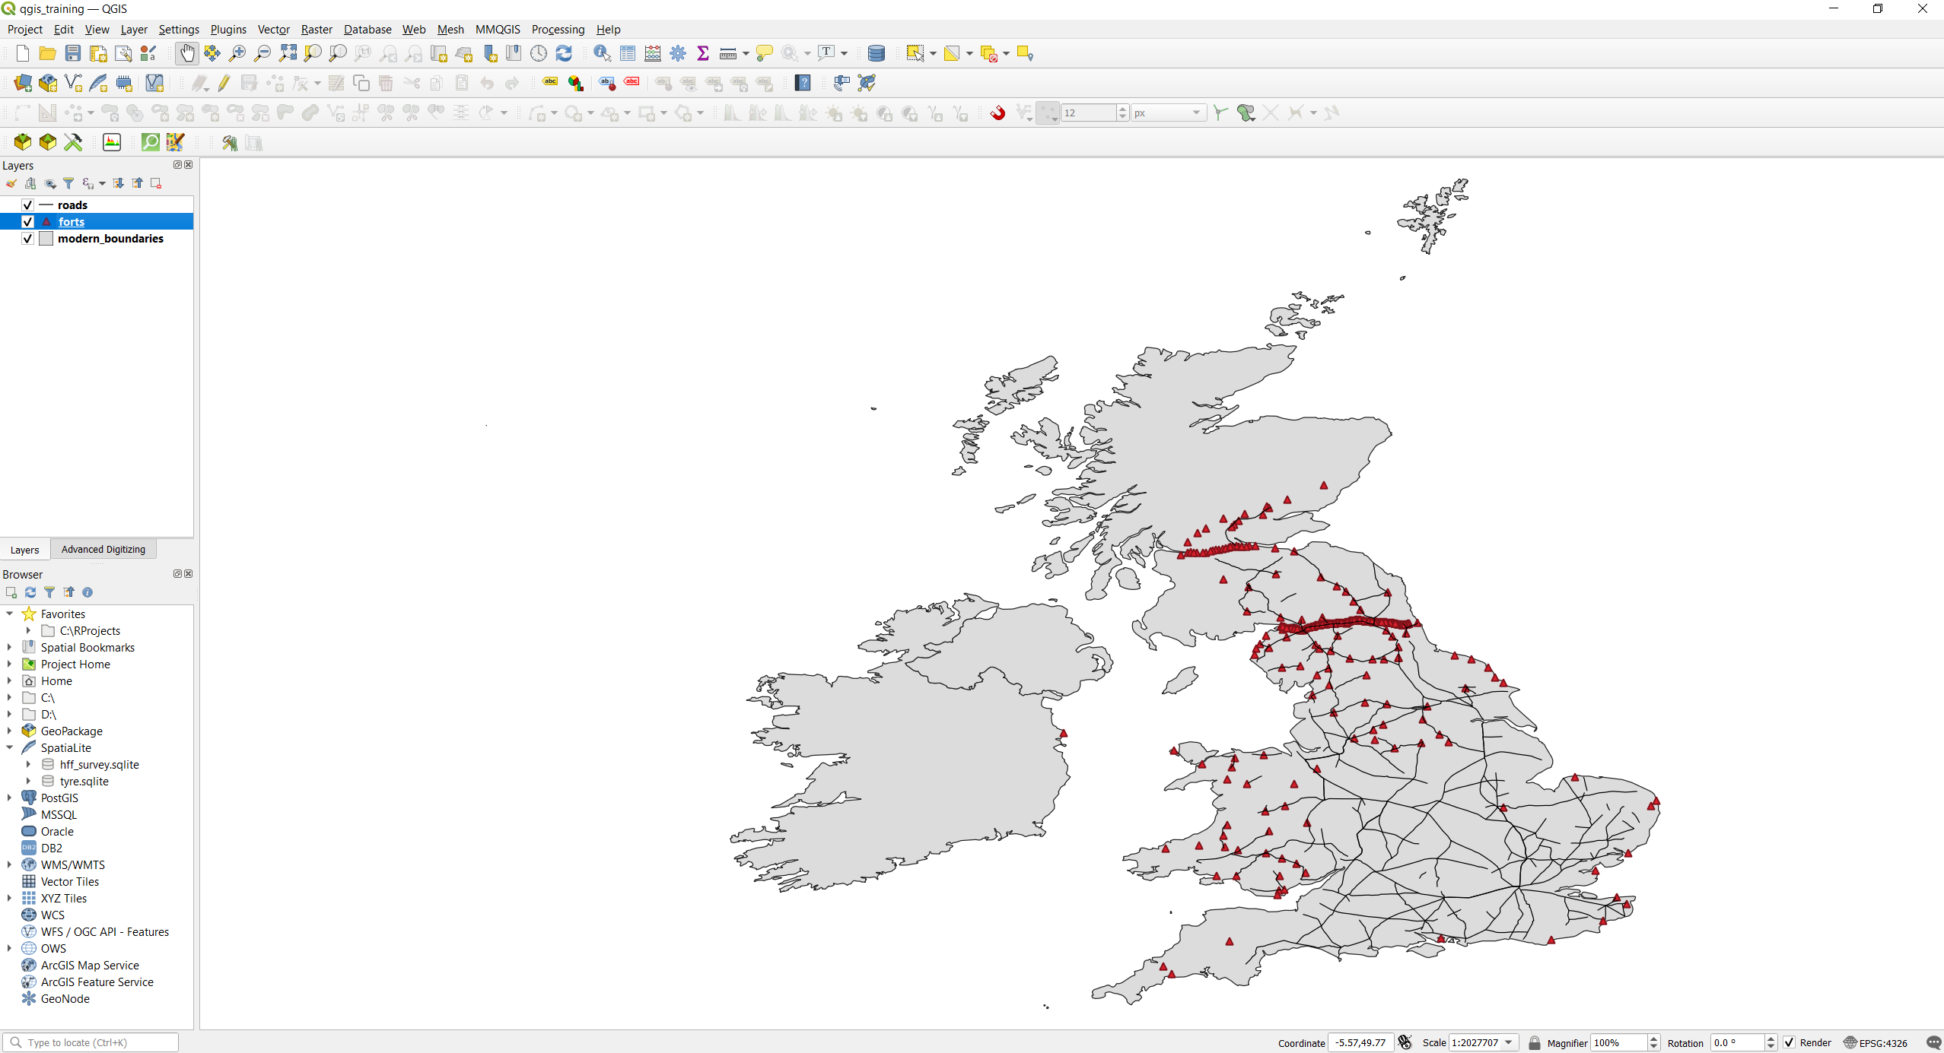
Some Considerations
We now have a more readable map. As you can see thanks to the fact that we have more than one information visible on the map, we can already make some observations.
We can observe how the forts are located in a linear pattern along the roads, especially in the North and to the West. This observation can lead to further questions, were those very important road? What if there were important settlements along them that the forts were supposed to protect?
All these observation leads to one consideration about how useful GIS is and what its potential is when using it in archaeology.
Using GIS is an exercise in observing and understanding the context, and not only the single, specific data. For example, without roads, we could have only observed how the forts are distributed on the landscape. But this, while important and relevant, is generally not enough, in order to understand the bigger picture we need to look at the context in which archaeological data are recorded, especially if we are working at a regional/national scale.
As you have seen, this is somewhat already possible just with a handful of data.

Slide 36
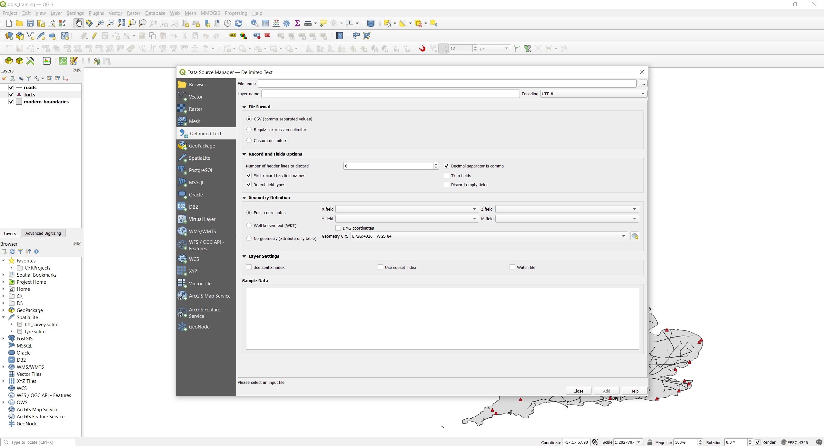
Load Data – Vectors - CSV
As mentioned earlier, another common file type is CSV (Comma Separated Value), these can be generated e.g. from an Excel file. We can load CSV files in QGIS by clicking again on “Open Source Manager” button on the top left, and then clicking on “Delimited Text” in the left toolbar of the new opened window.
1
2

Slide 37
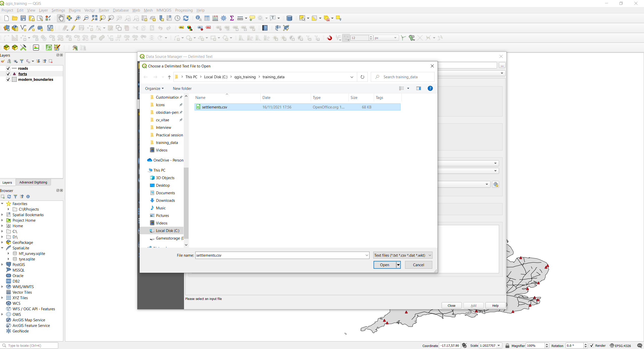
Load Data – Vectors - CSV
Click the three dots button and browse to the same folder as the previous data. Select settlements.csv and click “Open”
1
2
3

Slide 38
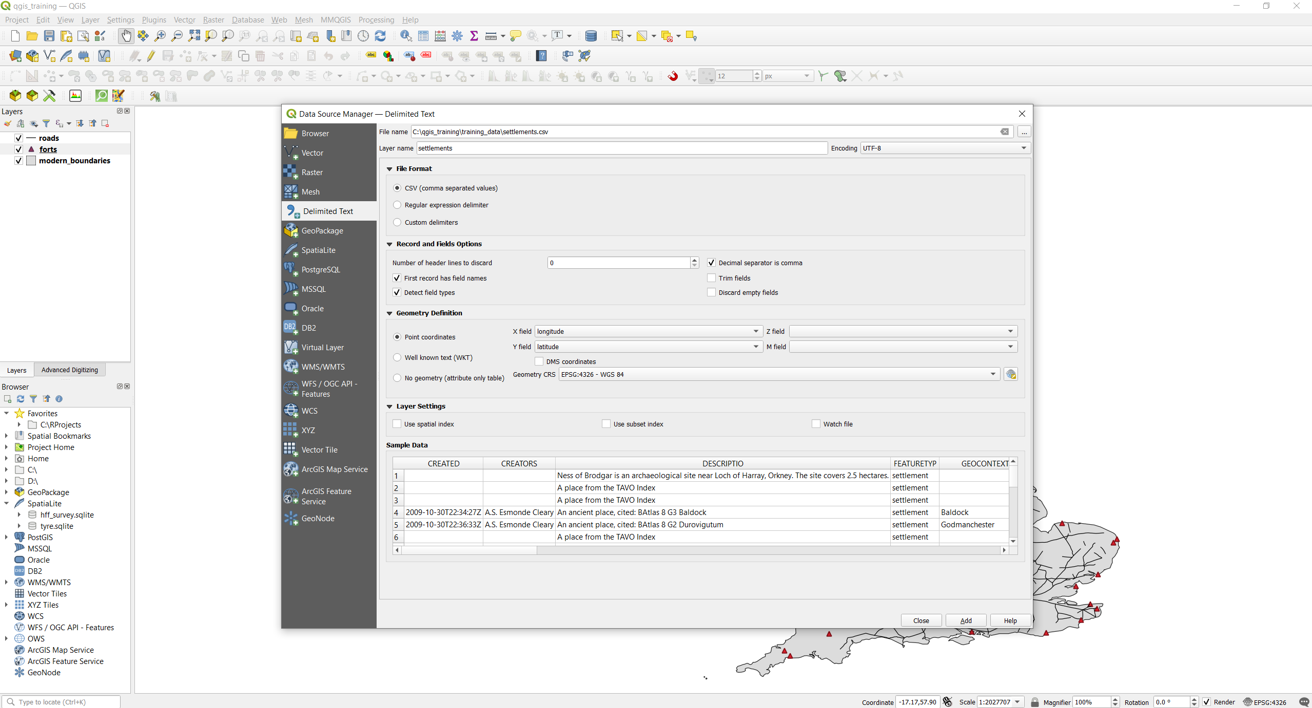
Load Data – Vectors - CSV
You can see now there a lot more option and things on this windows compared to the vector data. Usually QGIS is smart enough to read the CSV and adjust settings automatically. However, we need to check a couple of things to make sure that everything will be displayed correctly. Note how you can have a preview of the data structure under “Sample Data”

Slide 39
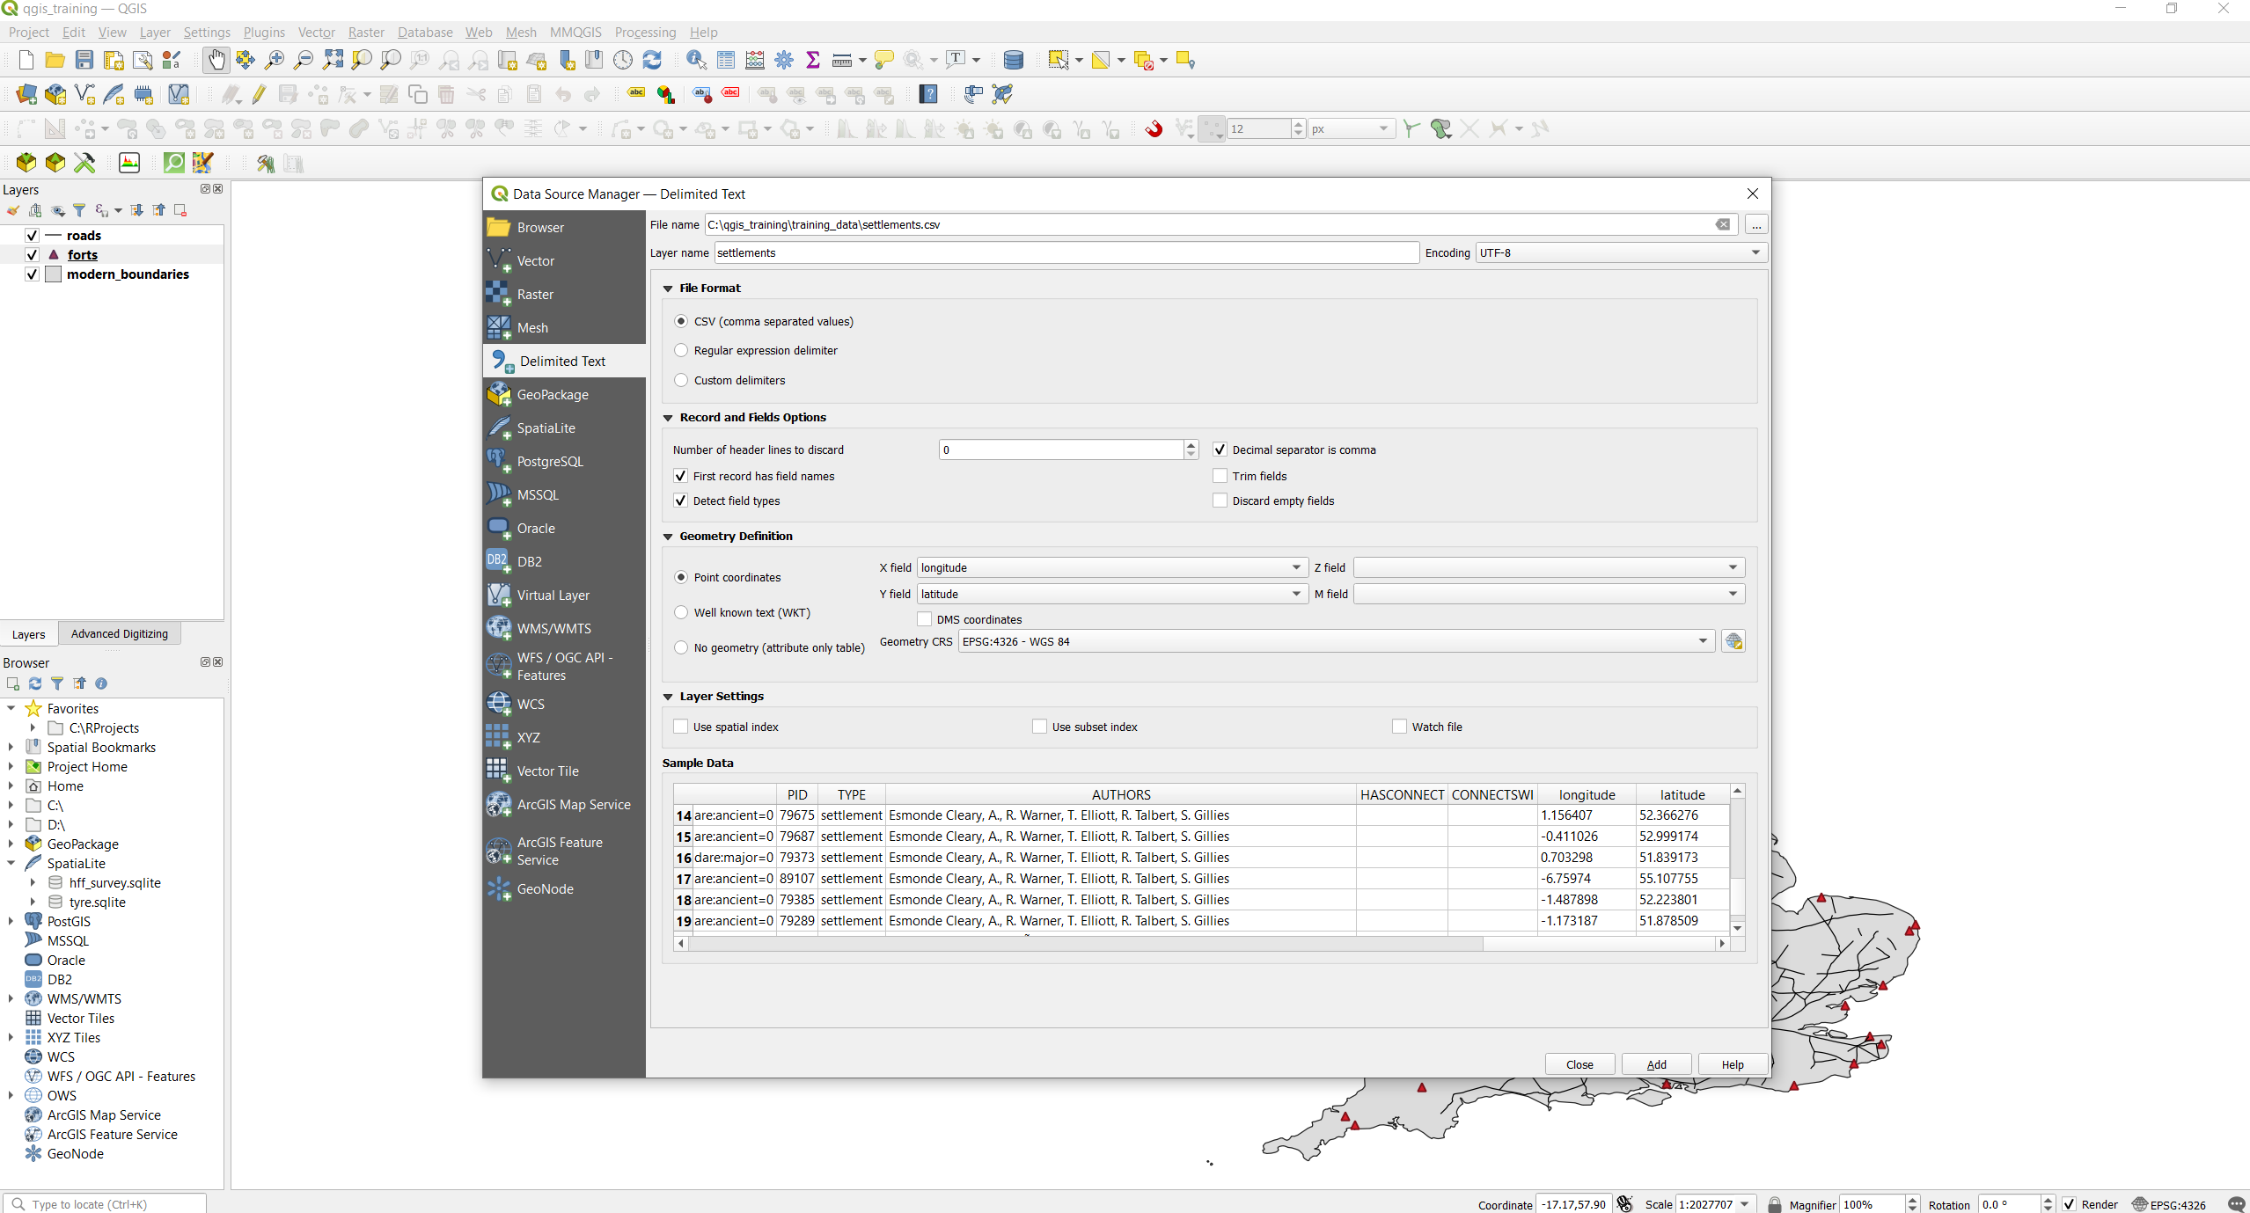
Load Data – Vectors – CSV
Under “File Format”, select CSV (tip: sometimes when your computer is not using English language, CSV might get messed up, if your file is not displayed correctly, select “Custom delimiters” and play around with the delimiters until the “Sample Data” Tab displays the file correctly).
Under “Record and Field Options”, make sure that “First record has field names”, “Decimal separator is comma”, and “Detect field types” are checked.
Under “Geometry Definition”, select “point coordinates” and in X field choose longitude, and in Y field choose latitude. This is mandatory for the points to show up! If your CSV file has no fields for coordinates, it will only appear as a table in the layers panel (Rember from the beginning: geographical coordinates are what turns simple data into spatial data, thus GIS-readable).
You can look at the longitude and latitude fields in your file by scrolling to the right with the bottom bar under “Sample Data”.
1
2
3

Slide 40
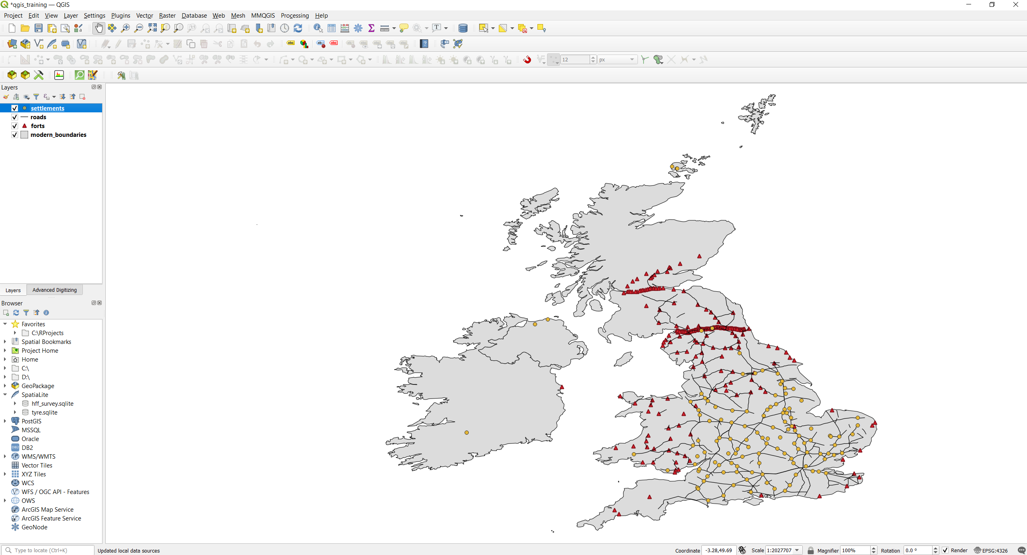
Load Data – Vectors – CSV
Click “Add” at the bottom and close this panel.
You can see that a new point layer has been added to the layers panel to the left, and on the map canvas as well.

Slide 41
Useful Links
Links to download this presentation in ppt or pdf: https://github.com/andreatitolo/qgis_training_data/raw/main/AT_Introduction_to_qgis.pptx
https://github.com/andreatitolo/qgis_training_data/raw/main/AT_Introduction_to_qgis.pdf
Link to download the data used for this presentation: https://github.com/andreatitolo/qgis_training_data/raw/main/training_data.zip
The original data can be downloaded at:
Ancient World Mapping Center: http://awmc.unc.edu/wordpress/map-files/
NaturalEarthData: https://www.naturalearthdata.com/downloads/
QGIS Website: https://qgis.org/en/site/
A Gentle Introduction to QGIS (very useful, well-explained clear examples and a few exercises): https://docs.qgis.org/3.16/en/docs/gentle_gis_introduction/index.html
QGIS Documentation: https://docs.qgis.org/3.16/en/docs/index.html
QGIS Training Manual: https://docs.qgis.org/3.16/en/docs/training_manual/index.html

